Slide 1
CS276: Information Retrieval and Web Search
Christopher Manning and Pandu Nayak
Lecture 13: Distributed Word Representations for Information Retrieval
Notes:
13 slides for IR part at end, so allow 15 mins for that. Cut off GloVe as needed!

Slide 2
How can we more robustly match a user’s search intent?
Sec. 9.2.2
We want to understand the query, not just do String equals()
If user searches for [Dell notebook battery size], we would like to match documents discussing “Dell laptop battery capacity”
If user searches for [Seattle motel], we would like to match documents containing “Seattle hotel”
A naïve information retrieval system does nothing to help
Simple facilities that we have already discussed do a bit to help
Spelling correction
Stemming / case folding
But we’d like to better understand when query/document match

Slide 3
How can we more robustly match a user’s search intent?
Sec. 9.2.2
Use of anchor text may solve this by providing human authored synonyms, but not for new or less popular web pages, or non-hyperlinked collections
Relevance feedback could allow us to capture this if we get near enough to matching documents with these words
We can also fix this with information on word similarities:
  A manual thesaurus of synonyms
  A measure of word similarity
    Calculated from a big document collection
    Calculated by query log mining (common on the web)

Slide 4
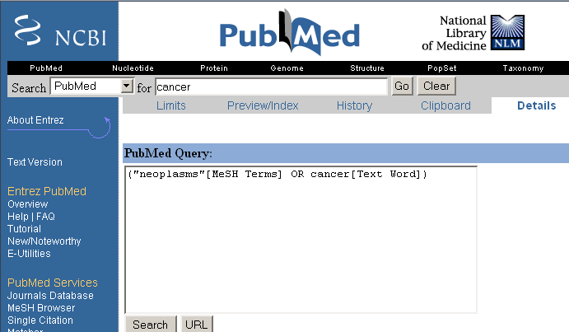
Example of manual thesaurus
Sec. 9.2.2
Notes:
E.g. MedLine: physician, syn: doc, doctor, MD, medico

Slide 5
Search log query expansion
Context-free query expansion ends up problematic
  [light hair] ≈ [fair hair] At least in U.K./Australia? ≈ blonde
    So expand [light] ⇒ [light fair]
  But [outdoor light price] ≠ [outdoor fair price]
You can learn query context-specific rewritings from search logs by attempting to identify the same user making a second attempt at the same user need
  [Hinton word vector]
  [Hinton word embedding]
In this context, [vector] ≈ [embedding]
  But not when talking about a disease vector or C++!

Slide 6
Automatic Thesaurus Generation
Sec. 9.2.3
Attempt to generate a thesaurus automatically by analyzing a collection of documents
Fundamental notion: similarity between two words
Definition 1: Two words are similar if they co-occur with similar words.
Definition 2: Two words are similar if they occur in a given grammatical relation with the same words.
You can harvest, peel, eat, prepare, etc. apples and pears, so apples and pears must be similar.
Co-occurrence based is more robust, grammatical relations are more accurate.
Why?

Slide 7
Simple Co-occurrence Thesaurus
Sec. 9.2.3
Simplest way to compute one is based on term-term similarities in C = AA^{T} where A is term-document matrix.
w_{i,j} = (normalized) weight for (t_{i} ,d_{j})
For each t_{i}, pick terms with high values in C
d_{j}
N
A
What does C contain if A is a term-doc incidence (0/1) matrix?
t_{i}
M

Slide 8
Automatic thesaurus generation example … sort of works
Word | Nearest neighbors
absolutely | absurd, whatsoever, totally, exactly, nothing
bottomed | dip, copper, drops, topped, slide, trimmed
captivating | shimmer, stunningly, superbly, plucky, witty
doghouse | dog, porch, crawling, beside, downstairs
makeup | repellent, lotion, glossy, sunscreen, skin, gel
mediating | reconciliation, negotiate, cease, conciliation
keeping | hoping, bring, wiping, could, some, would
lithographs | drawings, Picasso, Dali, sculptures, Gauguin
pathogens | toxins, bacteria, organisms, bacterial, parasites
senses | grasp, psyche, truly, clumsy, naïve, innate
But data is too sparse in this form 100,000 words = 10¹⁰ entries in C.

Slide 9
How can we represent term relations?
Sec. 9.2.2
With the standard symbolic encoding of terms, each term is a dimension
Different terms have no inherent similarity
motel [0 0 0 0 0 0 0 0 0 0 1 0 0 0 0]^{T}
hotel [0 0 0 0 0 0 0 3 0 0 0 0 0 0 0] = 0
If query on hotel and document has motel, then our query and document vectors are orthogonal

Slide 10
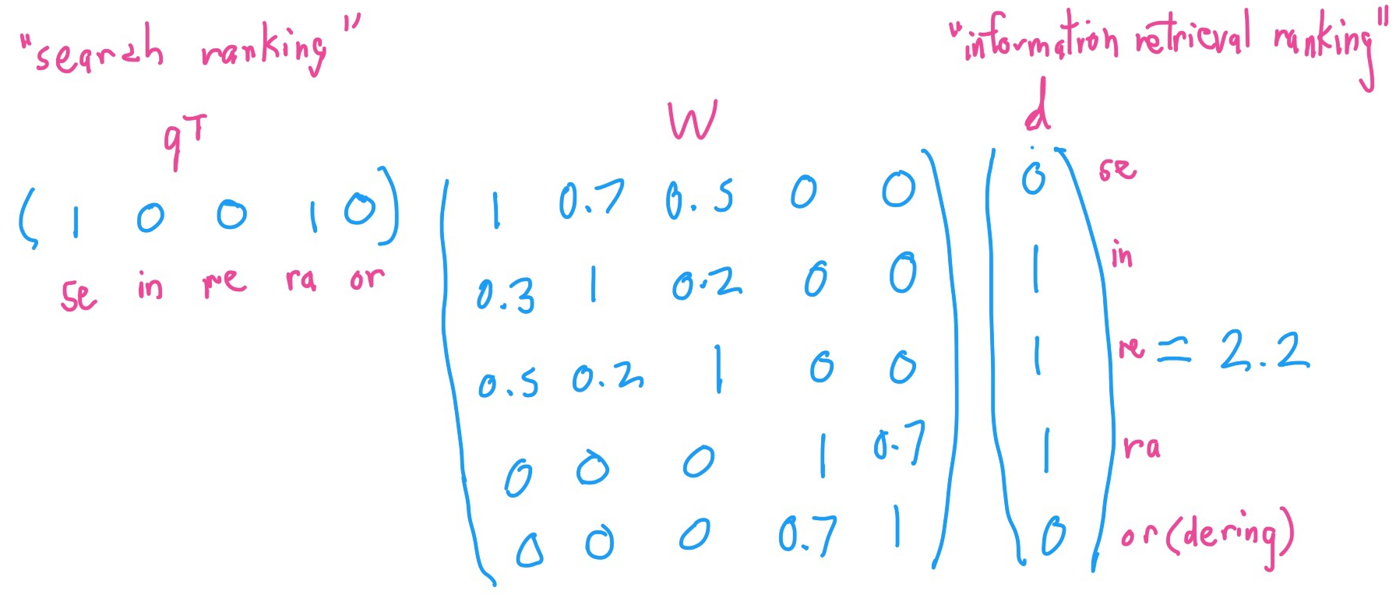
Can you directly learn term relations?
Basic IR is scoring on q^{T}d
No treatment of synonyms; no machine learning
Can we learn parameters W to rank via q^{T}Wd ?
Problem is again sparsity – W is huge > 10¹⁰
Notes:
Not necessarily symmetric – query language vs. collection language – medline neoplasm

Slide 11
Is there a better way?
Idea:
  Can we learn a dense low-dimensional representation of a word in ℝ^{d} such that dot products u^{T}v express word similarity?
  We could still if we want to include a “translation” matrix between vocabularies (e.g., cross-language): u^{T}Wv
    But now W is small!
  Supervised Semantic Indexing (Bai et al. Journal of Information Retrieval 2009) shows successful use of learning W for information retrieval
But we’ll develop direct similarity in this class

Slide 12
Distributional similarity based representations
You can get a lot of value by representing a word by means of its neighbors
“You shall know a word by the company it keeps”
(J. R. Firth 1957: 11)
One of the most successful ideas of modern statistical NLP
  government debt problems turning into banking crises as has happened in
  saying that Europe needs unified banking regulation to replace the hodgepodge
   These words will represent banking 
Notes:
You can vary whether you use local or large context to get a more syntactic or semantic clustering

Slide 13
Solution: Low dimensional vectors
The number of topics that people talk about is small (in some sense)
    Clothes, movies, politics, …
Idea: store “most” of the important information in a fixed, small number of dimensions: a dense vector
Usually 25 – 1000 dimensions
How to reduce the dimensionality?
  Go from big, sparse co-occurrence count vector to low dimensional “word embedding”

Slide 14
Traditional Way:
Latent Semantic Indexing/Analysis
Sec. 18.2
Use Singular Value Decomposition (SVD) – kind of like Principal Components Analysis (PCA) for an arbitrary rectangular matrix – or just random projection to find a low-dimensional basis or orthogonal vectors
Theory is that similarity is preserved as much as possible
You can actually gain in IR (slightly) by doing LSA, as “noise” of term variation gets replaced by semantic “concepts”
Popular in the 1990s [Deerwester et al. 1990, etc.]
  Results were always somewhat iffy (… it worked sometimes)
  Hard to implement efficiently in an IR system (dense vectors!)
Discussed in IIR chapter 18, but not discussed further here
  And not on the exam (!!!)

Slide 15
“Neural Embeddings”

Slide 16
Word meaning is defined in terms of vectors
We will build a dense vector for each word type, chosen so that it is good at predicting other words appearing in its context
… those other words also being represented by vectors … it all gets a bit recursive
linguistics =
0.286
0.792
−0.177
−0.107
0.109
−0.542
0.349
0.271
Notes:
For words that appear in the same contexts, you gain by making their vectors similar!
In probabilistic approaches, all the numbers are non-negative.

Slide 17
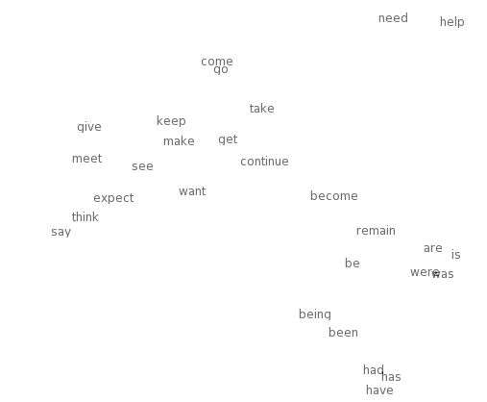

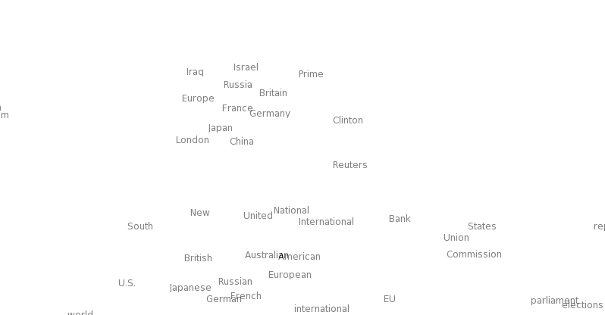
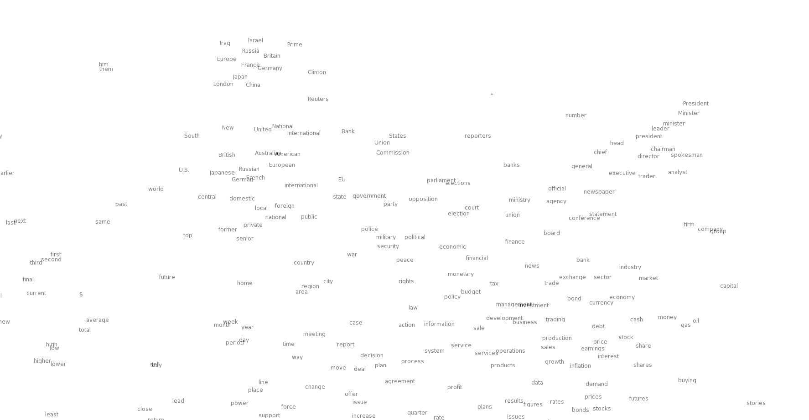
Neural word embeddings - visualization
Notes:
Let’s look at the idea of word vectors in a bit more detail before we describe our model.
…Large clouds of words with similar parts of speech and the smaller regions with similar meaning.
Why would we prefer this representation? To answer this question, let’s consider a commonly used alternative which is to represent words as an index into a vocabulary.

Slide 18
Basic idea of learning neural network word embeddings
We define a model that aims to predict between a center word w_{t} and context words in terms of word vectors
p(context|w_{t}) = …
which has a loss function, e.g.,
J = 1 − p(w_{−t} |w_{t})
We look at many positions t in a big language corpus
We keep adjusting the vector representations of words to minimize this loss
Notes:
The central new idea is that you change the word representation, as well as the other parameters of the model.
I’m going to directly and concretely build one, concrete prediction models. You may already know of some other things you might do, and we’ll come back to other possibilities next week, but this way of doing it is one of the best ways known.

Slide 19
Idea: Directly learn low-dimensional word vectors based on ability to predict
Old idea. Relevant for this lecture & deep learning:
  Learning representations by back-propagating errors. (Rumelhart et al., 1986)
  A neural probabilistic language model (Bengio et al., 2003)
  NLP (almost) from Scratch (Collobert & Weston, 2008)
  A recent, even simpler and faster model:
  word2vec (Mikolov et al. 2013) → intro now
  The GloVe model from Stanford (Pennington, Socher, and Manning 2014) connects back to matrix factorization
Initial models were quite non-linear and slow; recent work has used fast, bilinear models

Slide 20
Word2vec is a family of algorithms
[Mikolov et al. 2013]
  Predict between every word and its context words!
Two algorithms
  Skip-grams (SG)
    Predict context words given target (position independent)
  Continuous Bag of Words (CBOW)
    Predict target word from bag-of-words context
Two (moderately efficient) training methods
  Hierarchical softmax
  Negative sampling
  Naïve softmax

Slide 21
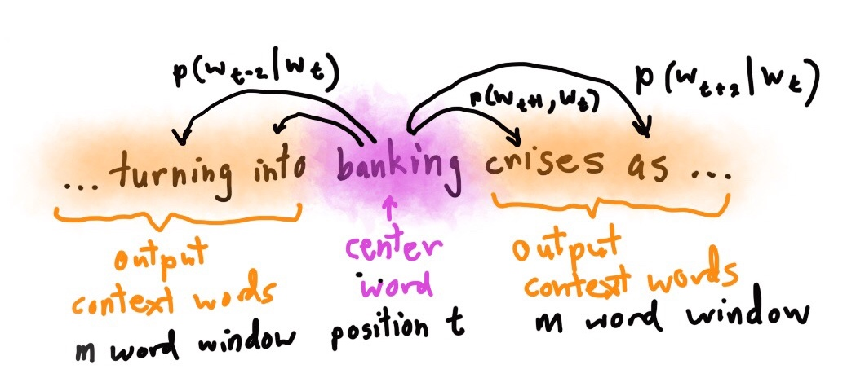
Skip-gram prediction
Notes:
Make a picture!

Slide 22
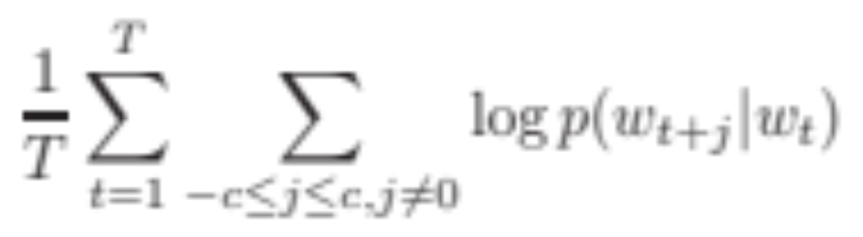
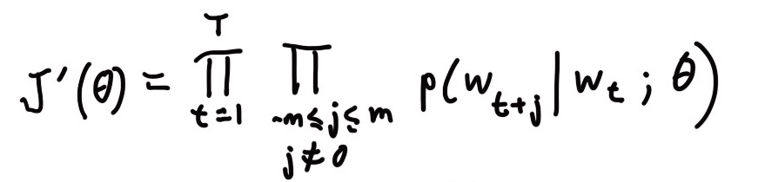
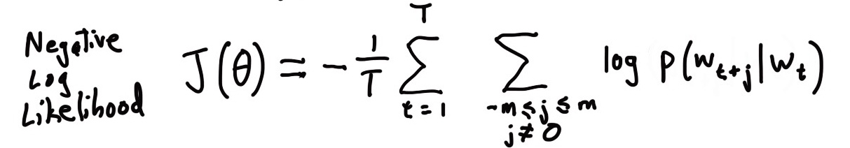
Details of word2vec
For each word t = 1 … T, predict surrounding words in a window of “radius” m of every word.
Objective function: Maximize the probability of any context word given the current center word:
Where θ represents all variables we will optimize
Notes:
Add slide with window picture
Draw windows example. How does this give us vectors?

Slide 23
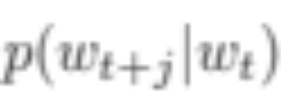
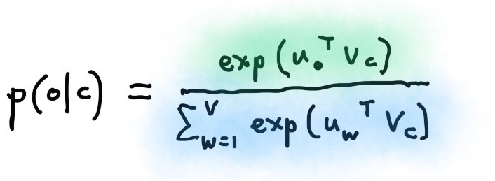
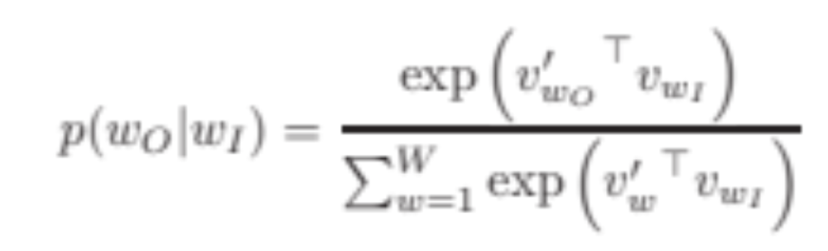
Details of Word2Vec
Predict surrounding words in a window of radius m of every word
For the simplest first formulation is
where o is the outside (or output) word index, c is the center word index, v_{c} and u_{o} are “center” and “outside” vectors of indices c and o
Softmax using word c to obtain probability of word o
Notes:
Move bullet to slide with picture.
Two vectors makes math easier and generally works a fraction better.
We’ve seen dot products before a lot.
Softmax or maxent.

Slide 24
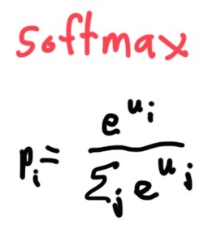
Softmax function: Standard map from ℝ^{V} to a probability distribution
Exponentiate to
make positive
Normalize to
give probability

Slide 25
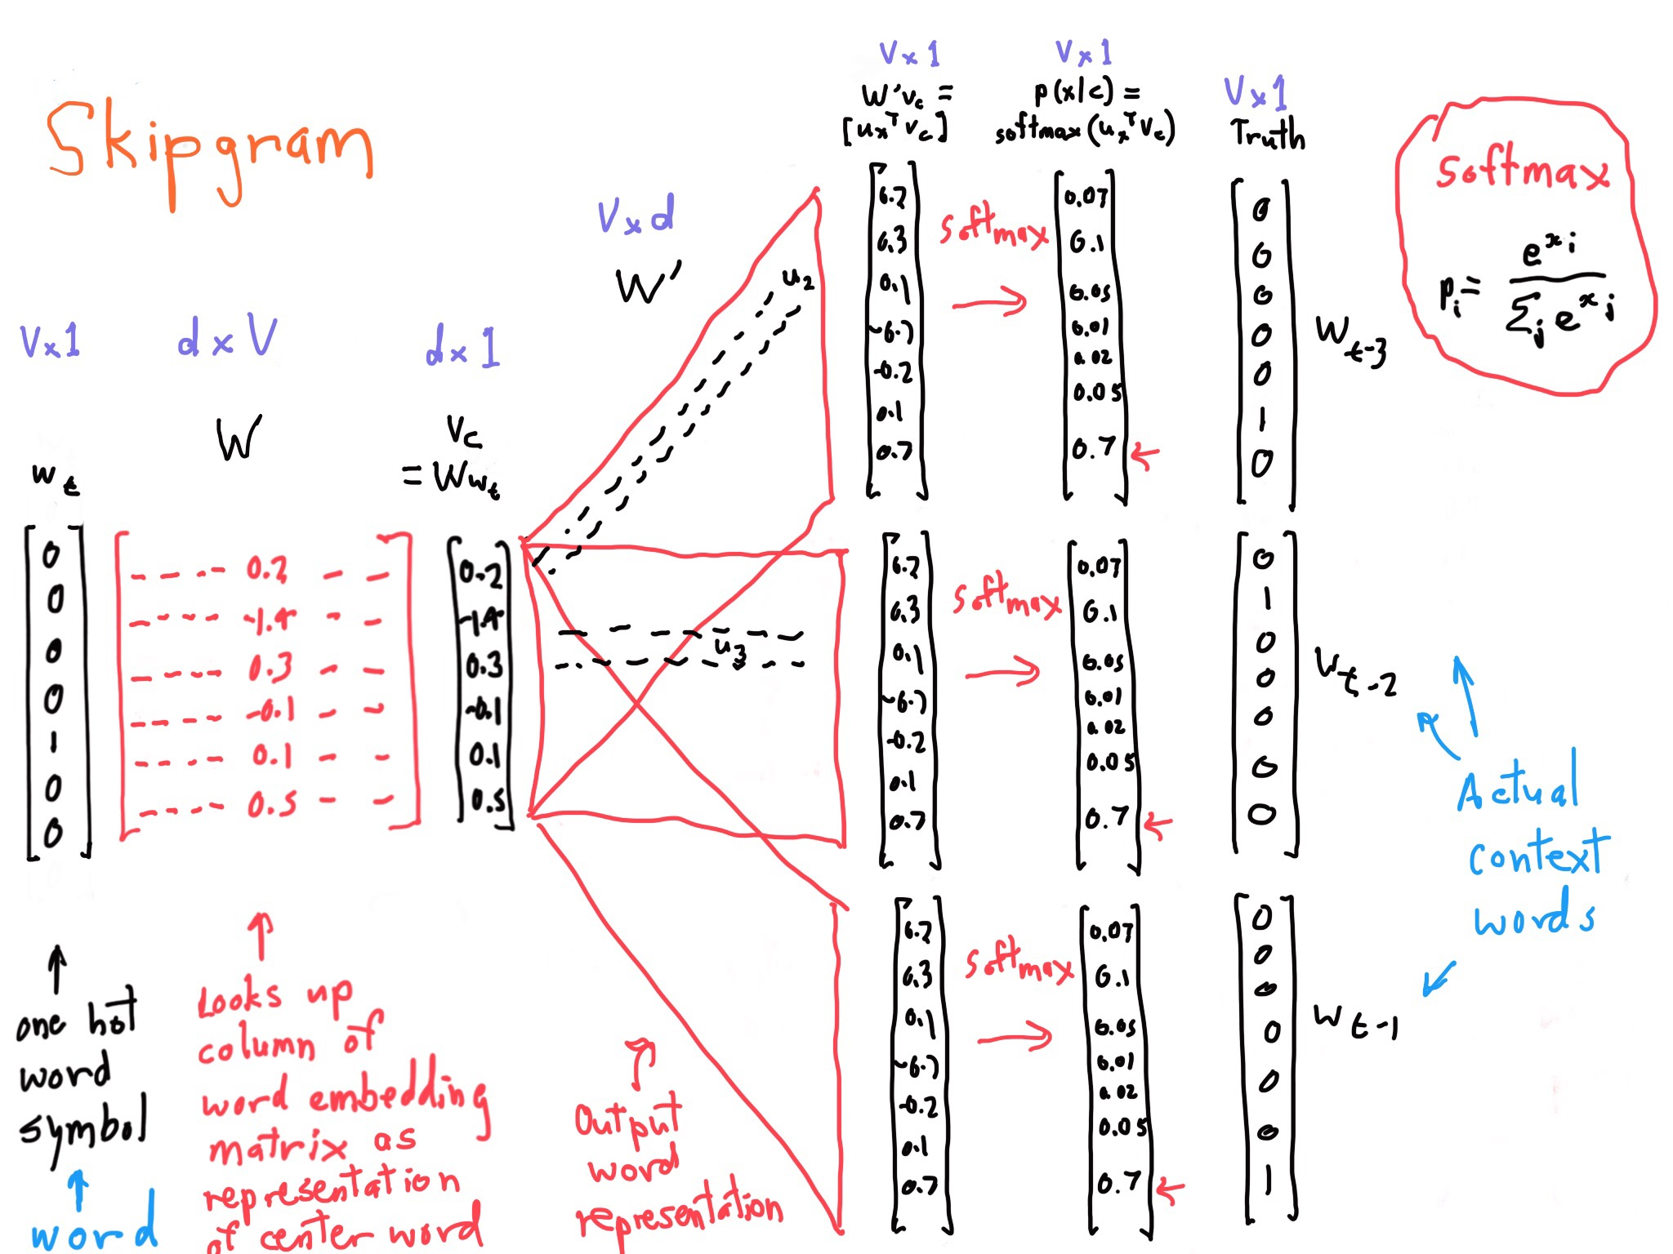
Skip gram model structure
Notes:
You have the same parameters for each matrix in the middle, replicated for each position!

Slide 26

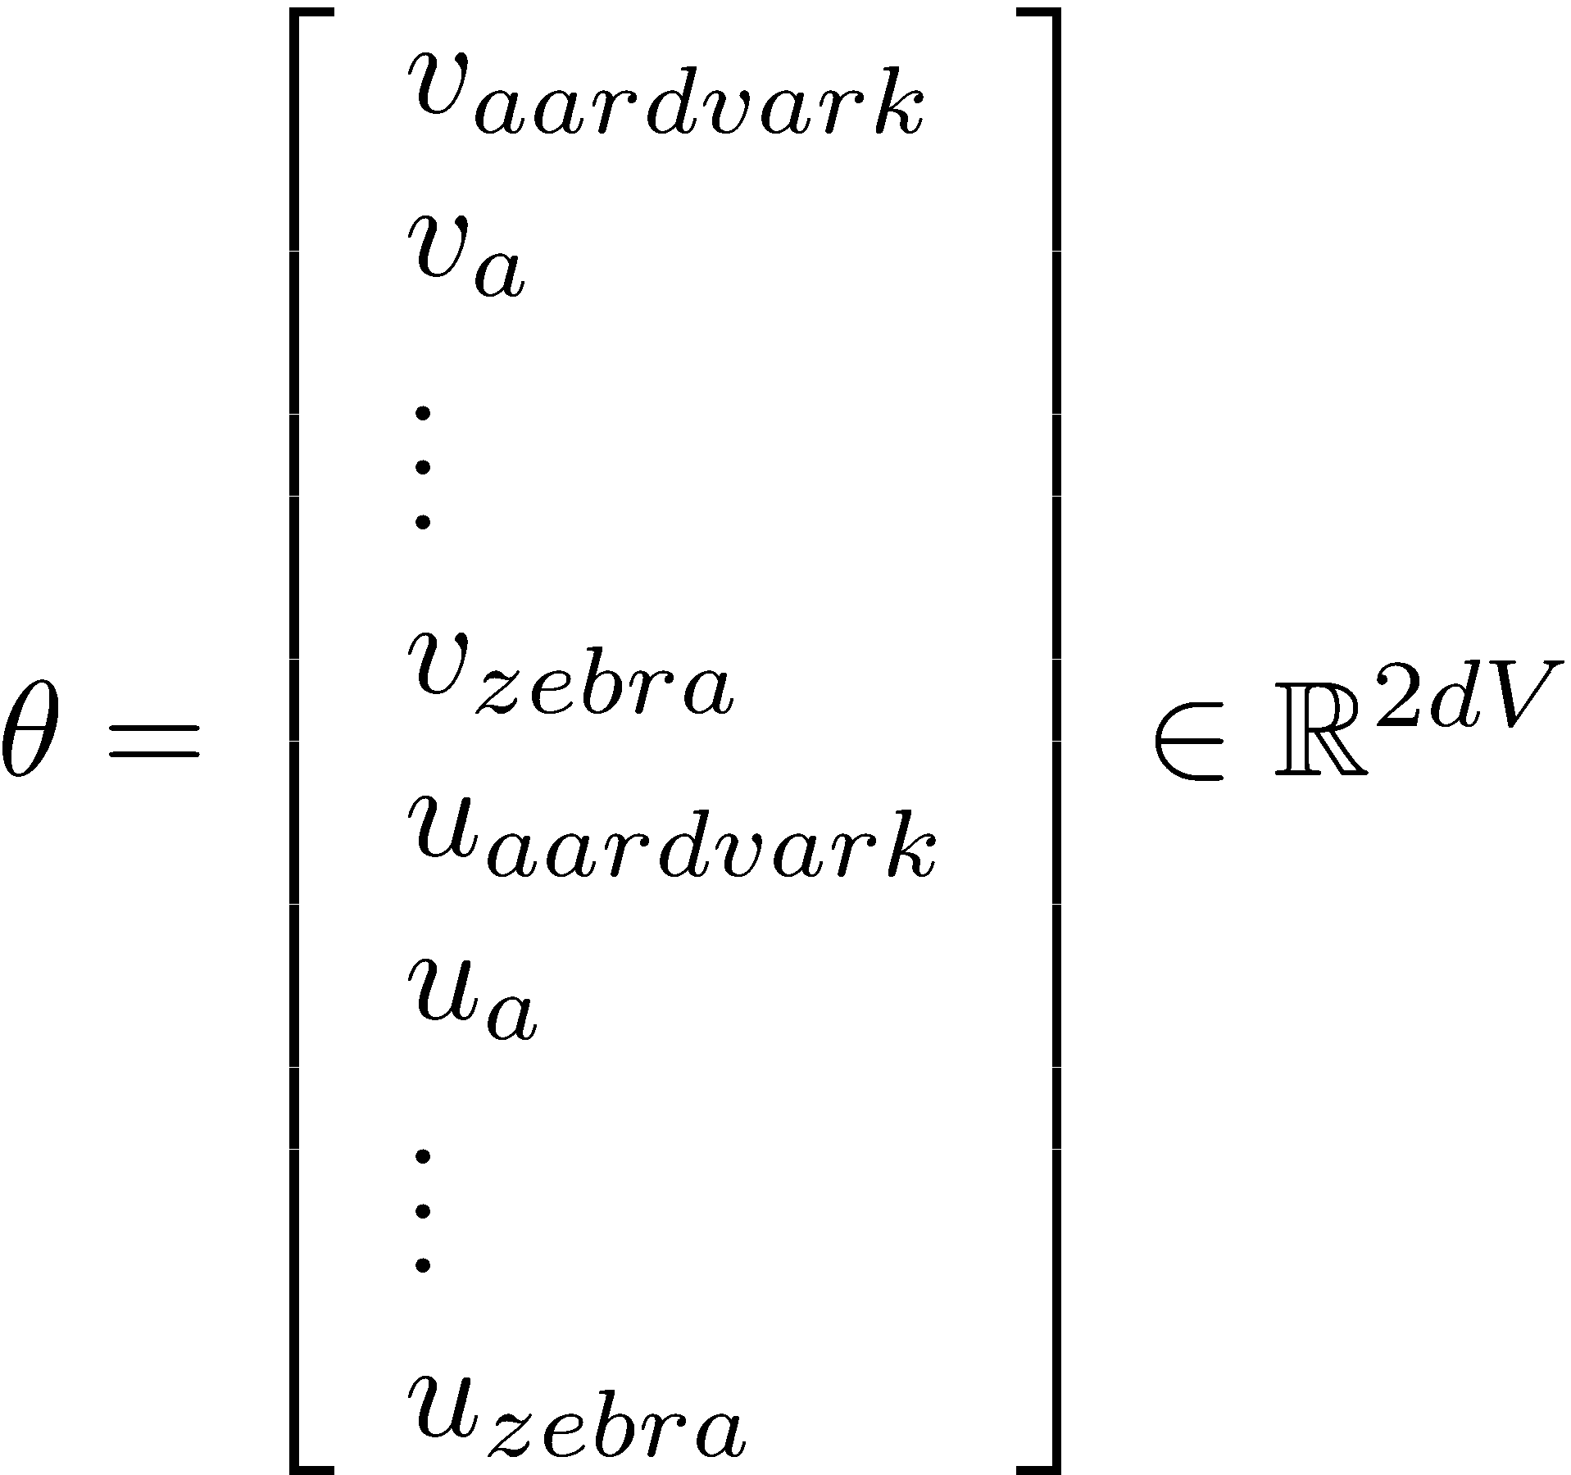
To learn good word vectors:
Compute all vector gradients!
We often define the set of all parameters in a model in terms of one long vector
In our case with
d-dimensional vectors
and
V many words:
We then optimize
these parameters
Note: Every word has two vectors! Makes it simpler!

Slide 27
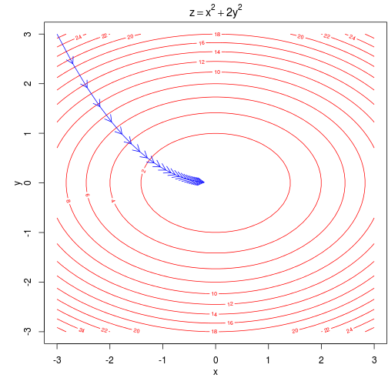
Intuition of how to minimize loss for a simple function over two parameters
We start at a random point and walk in the steepest direction, which is given by the derivative of the function
Contour lines show points of equal value of objective function
Notes:
Ignore other optimization algorithms, for now just SGD
Our objective function is of course a lot higher dimensional and complex!

Slide 28
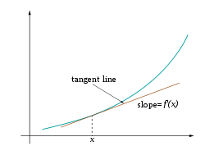
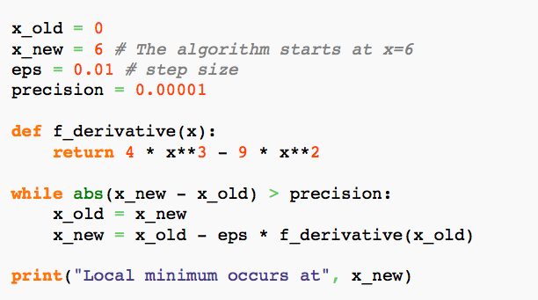
Descending by using derivatives
We will minimize a cost function by
gradient descent
Trivial example: (from Wikipedia)
Find a local minimum of the function
f(x) = x⁴−3x³+2,
with derivative f'(x) = 4x³−9x²
Subtracting a fraction of the gradient moves you towards the minimum!
Notes:
Put minus in front and you can maximize.
This is single variable, whereas we’re doing it over a vector of parameters. And a batch of examples.

Slide 29
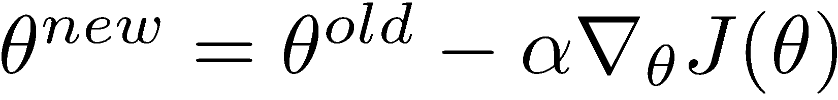
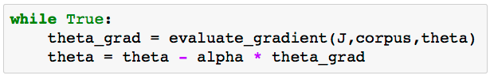
Vanilla Gradient Descent Code

Slide 30
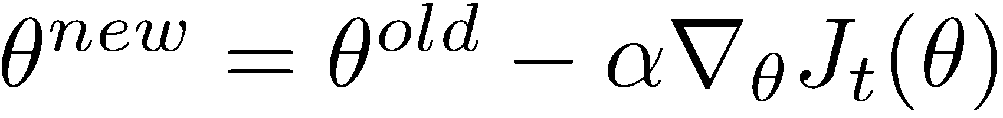
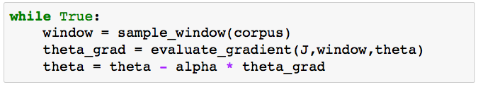
Stochastic Gradient Descent
But Corpus may have 40B tokens and windows
You would wait a very long time before making a single update!
Very bad idea for pretty much all neural nets!
Instead: We will update parameters after each window t
→ Stochastic gradient descent (SGD)
Notes:
in practice we have a maximum number of iterations
More tricks and details in later lectures!
Crazily noisy estimate of the gradient. But we repeat over many times quickly, so it sort of works out. In fact you often win.
Like force directed graph layout!

Slide 31
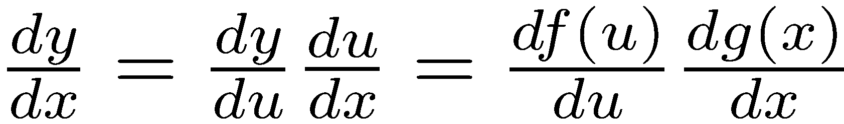
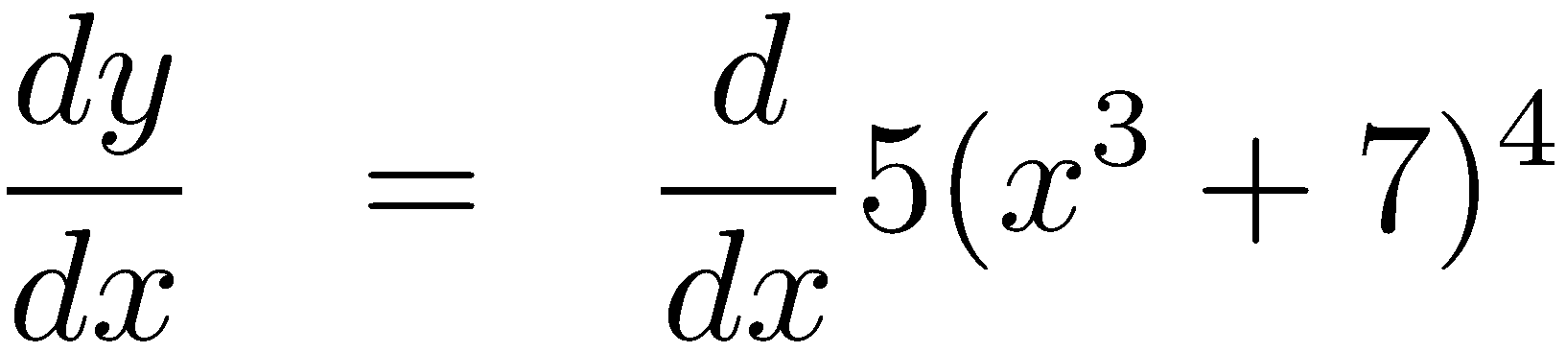
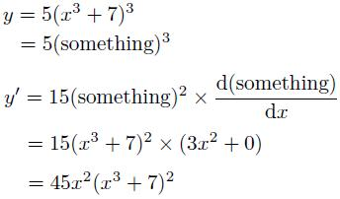
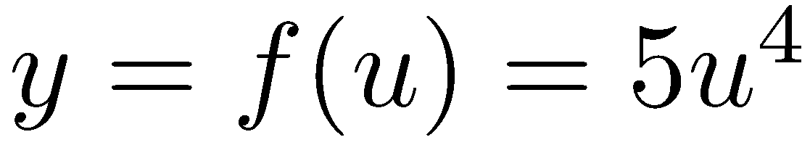
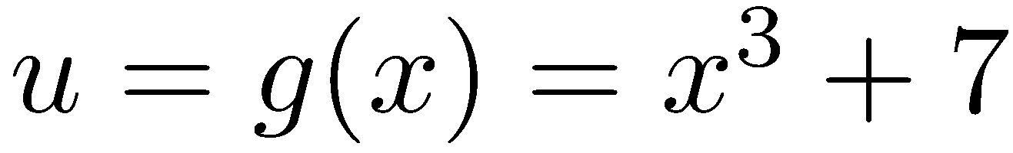
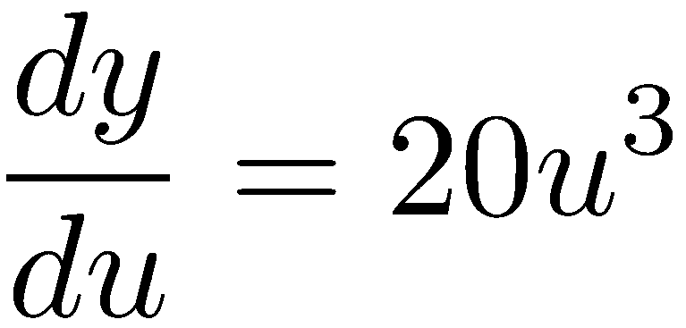
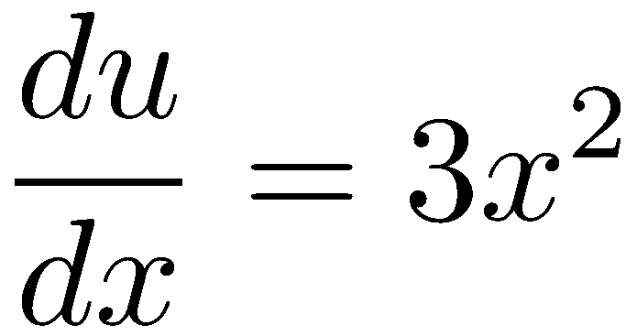
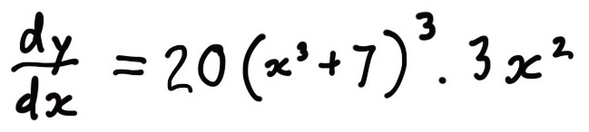
Working out how to optimize a neural network is really all the chain rule!
Chain rule! If y = f(u) and u = g(x), i.e. y = f(g(x)), then:
Simple example:
Notes:
(Leibniz notation):
Also called “backpropagation”

Slide 32
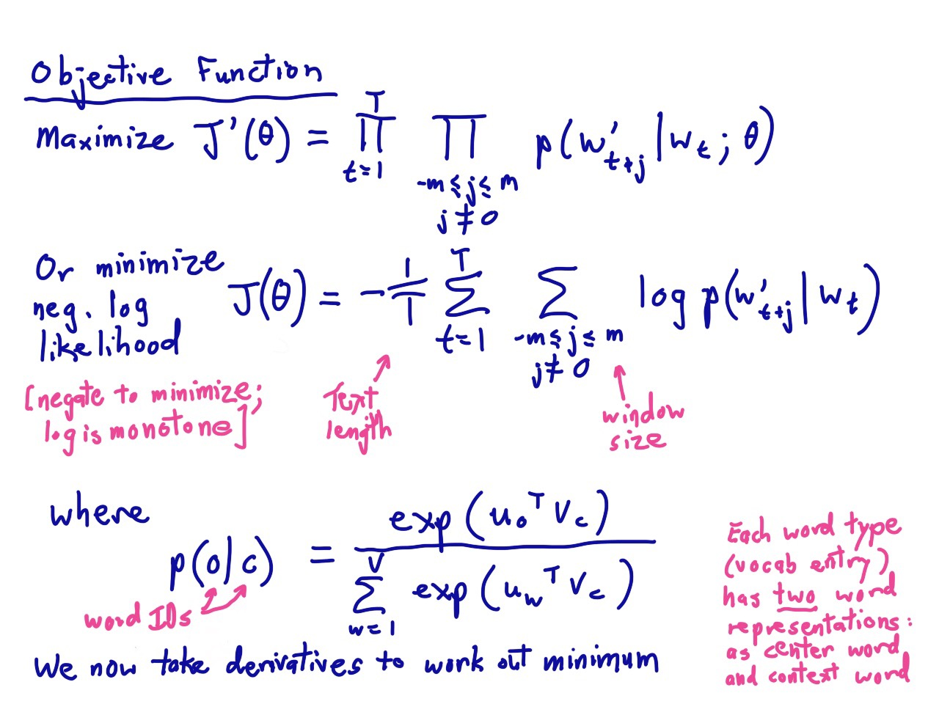
Notes:
Here’s our word vector model again.
AIM TO HAVE 5 MINUTES AFTER CALCULUS!

Slide 33
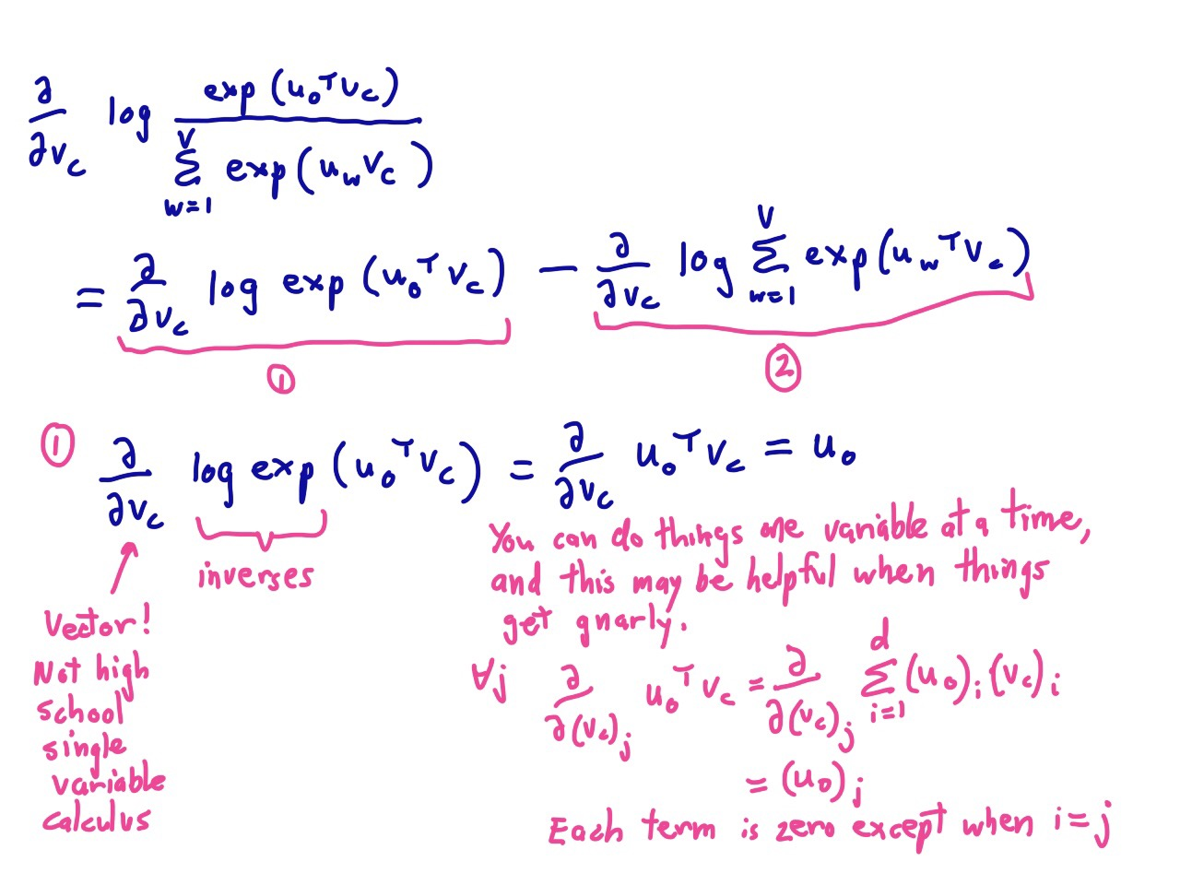

Slide 34
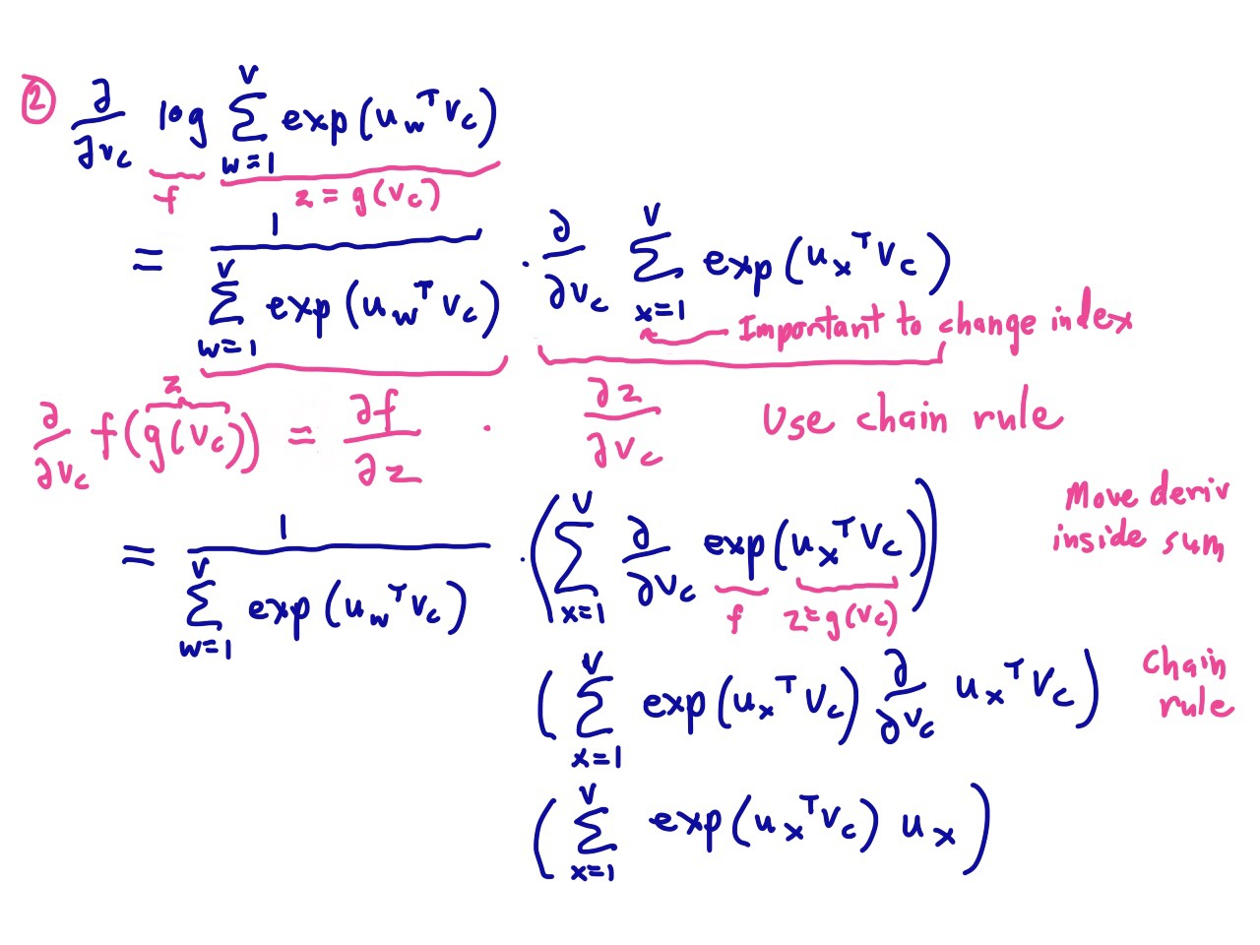

Slide 35
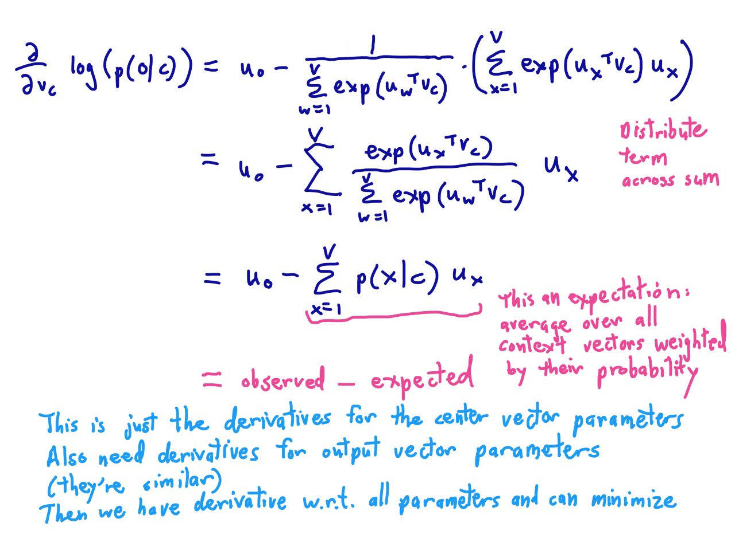

Slide 36
Notes:
But if we then run gradient descent using those calculated derivatives, after a while, a miracle occurs.

Slide 37
Linear Relationships in word2vec
These representations are very good at encoding similarity and dimensions of similarity!
Analogies testing dimensions of similarity can be solved quite well just by doing vector subtraction in the embedding space
  Syntactically
  x_{apple} − x_{apples} ≈ x_{car} − x_{cars} ≈ x_{family} − x_{families}
  Similarly for verb and adjective morphological forms
  Semantically (Semeval 2012 task 2)
  x_{shirt} − x_{clothing} ≈ x_{chair} − x_{furniture}
  x_{king} − x_{man} ≈ x_{queen} − x_{woman}

Slide 38
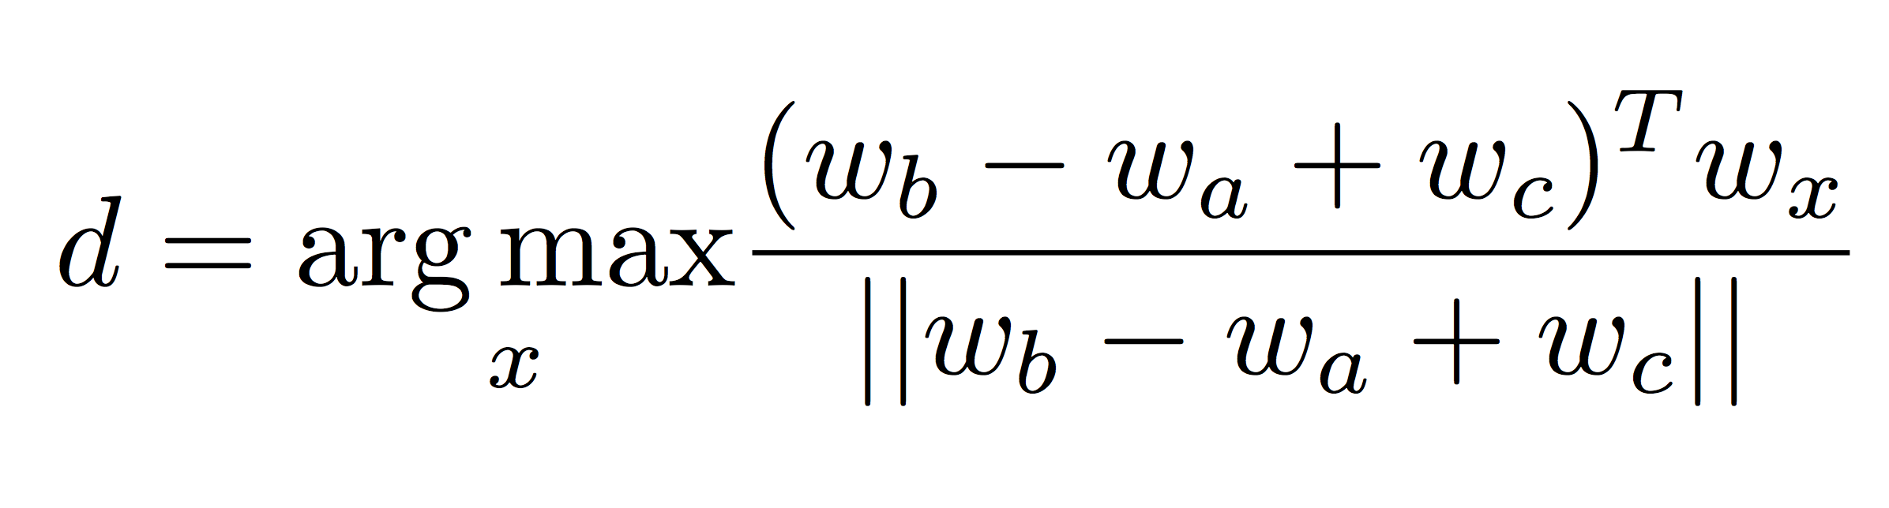
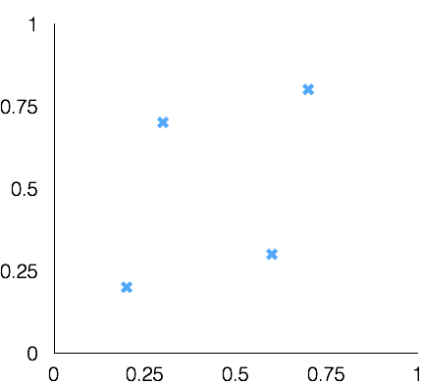
Word Analogies
Test for linear relationships, examined by Mikolov et al.
a:b :: c:?
a:b :: c:?
man:woman :: king:?
+
king
[ 0.30 0.70 ]
queen
king
−
man
[ 0.20 0.20 ]
+
woman
[ 0.60 0.30 ]
woman
queen
[ 0.70 0.80 ]
man

Slide 39
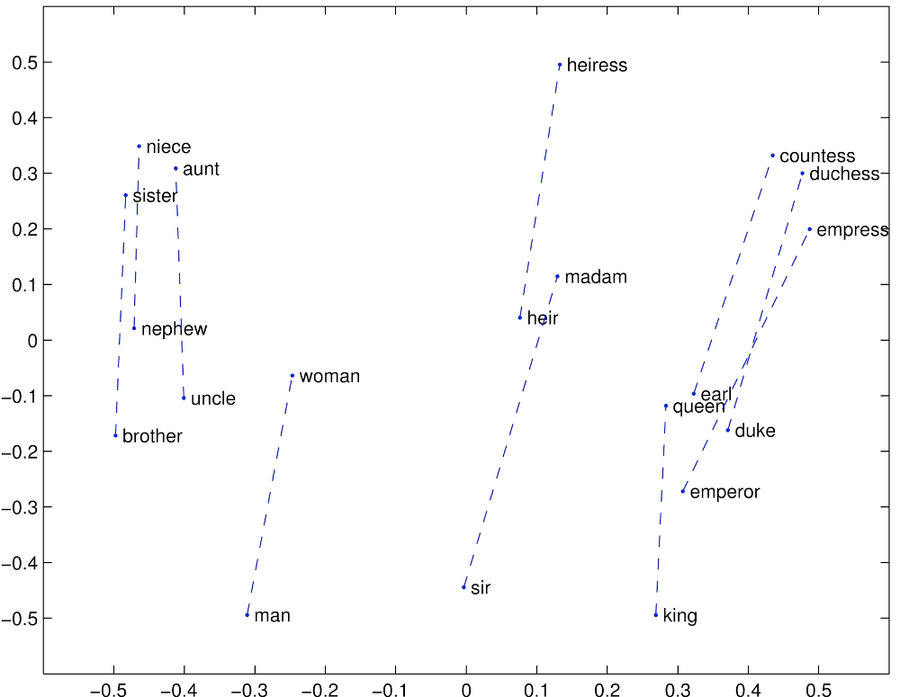
GloVe Visualizations
http://nlp.stanford.edu/projects/glove/

Slide 40
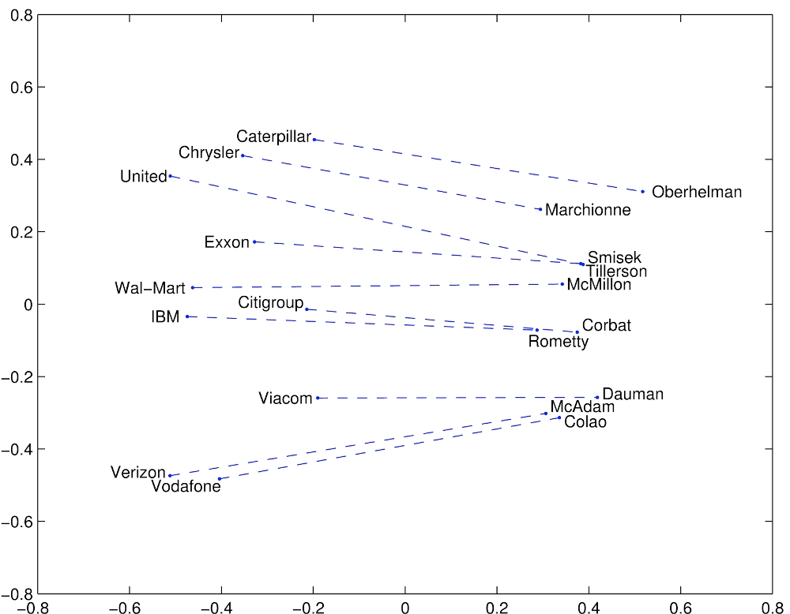
Glove Visualizations: Company - CEO

Slide 41
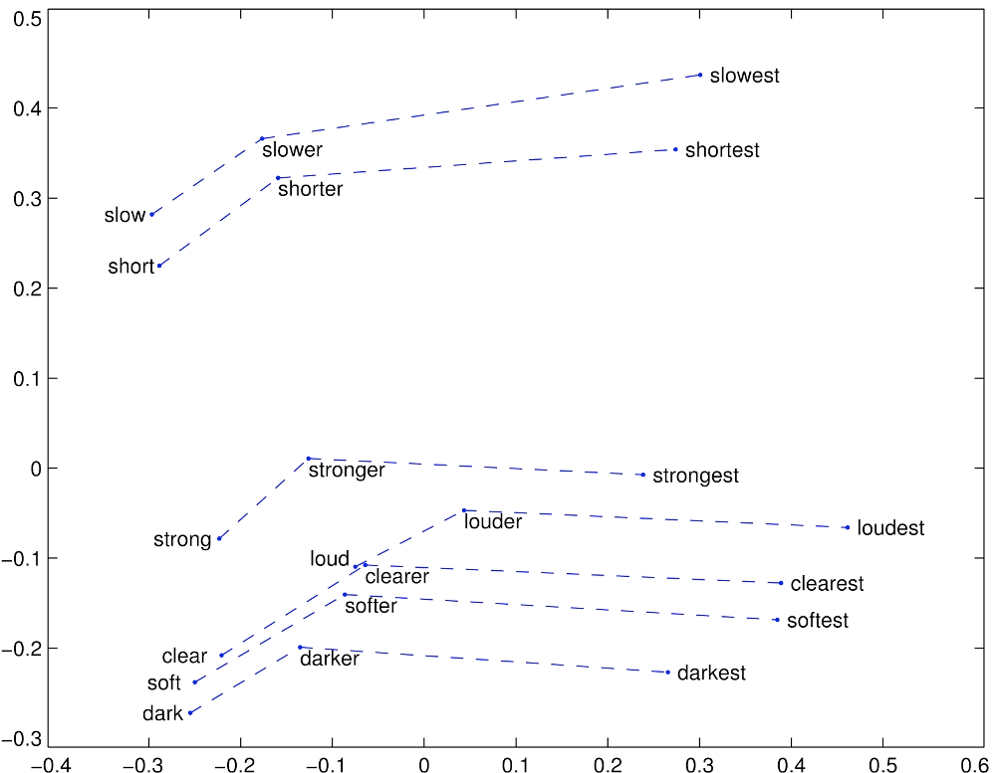
Glove Visualizations: Superlatives

Slide 42

Application to Information Retrieval
Application is just beginning – there’s little to go on
Google’s RankBrain – almost nothing is publicly known
  Bloomberg article by Jack Clark (Oct 26, 2015): http://www.bloomberg.com/news/articles/2015-10-26/google-turning-its-lucrative-web-search-over-to-ai-machines
  A result reranking system
  Even though more of the value is in the tail?
New SIGIR Neu-IR workshop series (2016 and 2017)
Notes:
Remember also RankNet for learning to rank – but here we are interested in neural distributed representations of words.

Slide 43
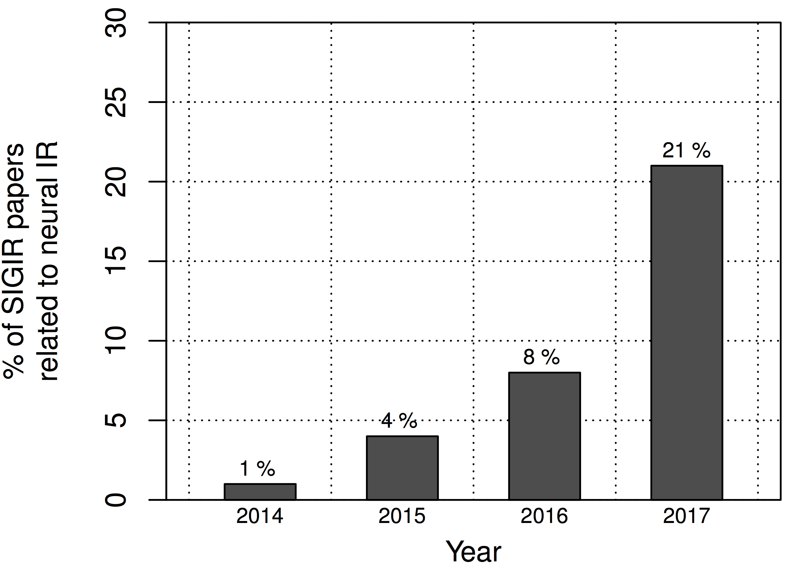
Final Thoughts from Chris Manning SIGIR 2016 keynote
2011 2013 2015 2017
speech vision NLP IR
You are
here
Notes:
I’m sure deep learning will come to dominate SIGIR over the next couple of years … just like speech, vision, and NLP before it.
This is a good thing. There are some powerful new techniques that are just being amazingly successful on many hard applied problems.
However, we should realize that there is also currently a huge amount of hype about deep learning and artificial intelligence. We should not let a genuine enthusiasm for important, successf new techniques lead to irrational exuberance or diminish appreciation for other approaches.
Despite the efforts of a number of people, there has been division of HLT. Time for synergy? Organizational issues?

Slide 44
An application to information retrieval
Nalisnick, Mitra, Craswell & Caruana. 2016. Improving Document Ranking with Dual Word Embeddings. WWW 2016 Companion. http://research.microsoft.com/pubs/260867/pp1291-Nalisnick.pdf
Mitra, Nalisnick, Craswell & Caruana. 2016. A Dual Embedding Space Model for Document Ranking. arXiv:1602.01137 [cs.IR]
Builds on BM25 model idea of “aboutness”
Not just term repetition indicating aboutness
Relationship between query terms and all terms in the document indicates aboutness (BM25 uses only query terms)
Makes clever argument for different use of word and context vectors in word2vec’s CBOW/SGNS or GloVe
Notes:
People at/working with Bing.
Probably not the definitive paper. But it exists today?

Slide 45
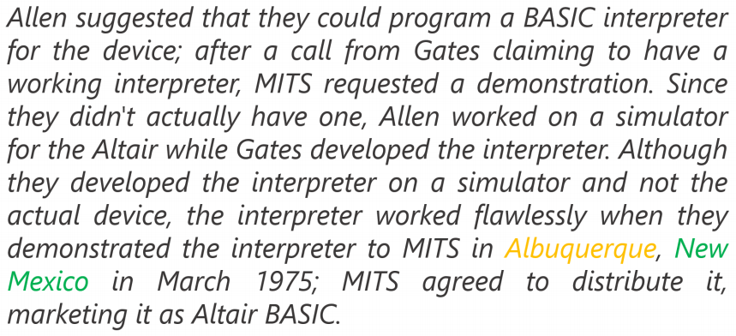
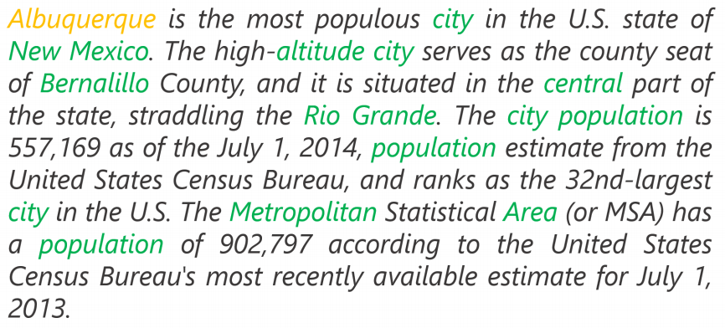
Modeling document aboutness:
Results from a search for Albuquerque
d₁
d₂
Notes:
Both documents have 1 occurrence of the search term, but d2 has a lot more words that commonly co-occur with the search term. This is strong evidence that it is about the search term.

Slide 46
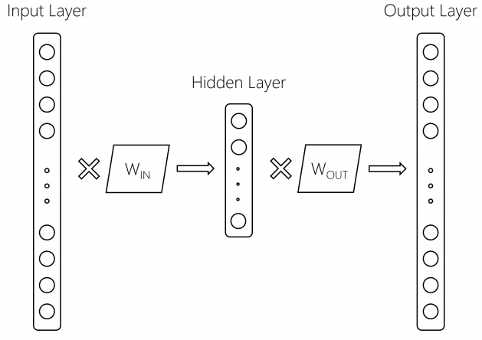
Using 2 word embeddings
word2vec model with 1 word of context
W_{IN}
Embeddings
for focus
words
W_{OUT}
Embeddings
for context
words
Focus
word
Context
word
We can gain by using these
two embeddings differently
Notes:
Current exploitation is usually:
Just throw the context embeddings away (word2vec) – or paper says it always uses Win, which would be funnier but may be true.
Average them (GloVe) – gave gains

Slide 47
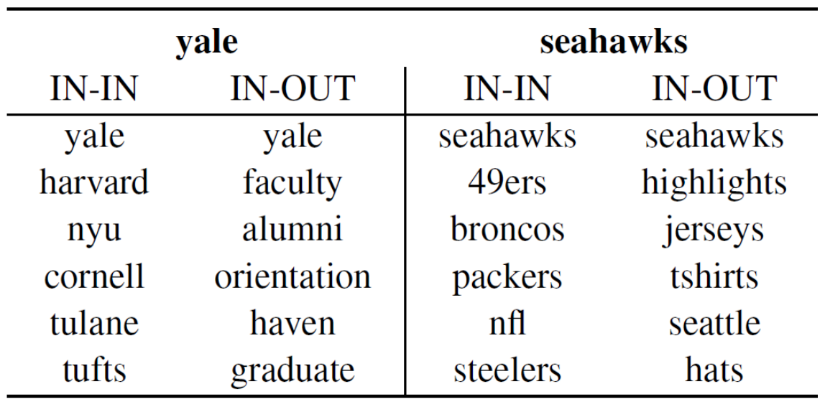
Using 2 word embeddings
Notes:
Either IN-IN or OUT-OUT give a similar ranking that is good for similarity – words that appear in the same context (word similarity).
But for DESM, they are wanting to see whether this is a context about this word, and so they use IN-OUT similarity

Slide 48
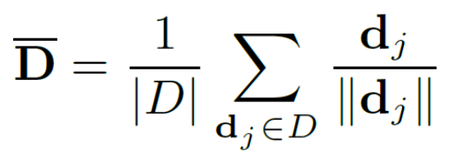
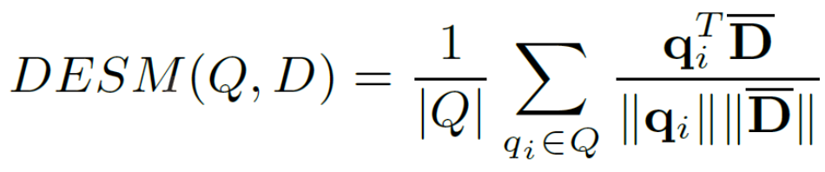
Dual Embedding Space Model (DESM)
Simple model
A document is represented by the centroid of its word vectors
Query-document similarity is average over query words of cosine similarity

Slide 49
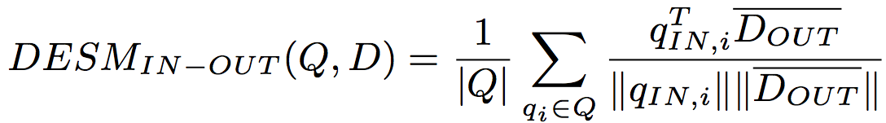
Dual Embedding Space Model (DESM)
What works best is to use the OUT vectors for the document and the IN vectors for the query
This way similarity measures aboutness – words that appear with this word – which is more useful in this context than (distributional) semantic similarity

Slide 50
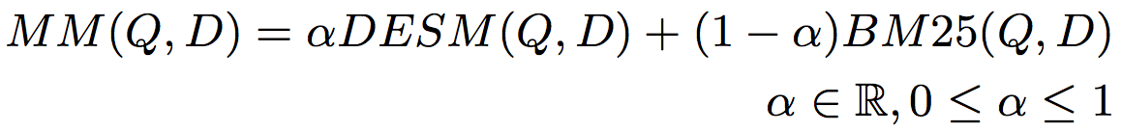
Experiments
Train word2vec from either
  600 million Bing queries
  342 million web document sentences
Test on 7,741 randomly sampled Bing queries
  5 level eval (Perfect, Excellent, Good, Fair, Bad)
Two approaches
  Use DESM model to rerank top results from BM25
  Use DESM alone or a mixture model of it and BM25

Slide 51
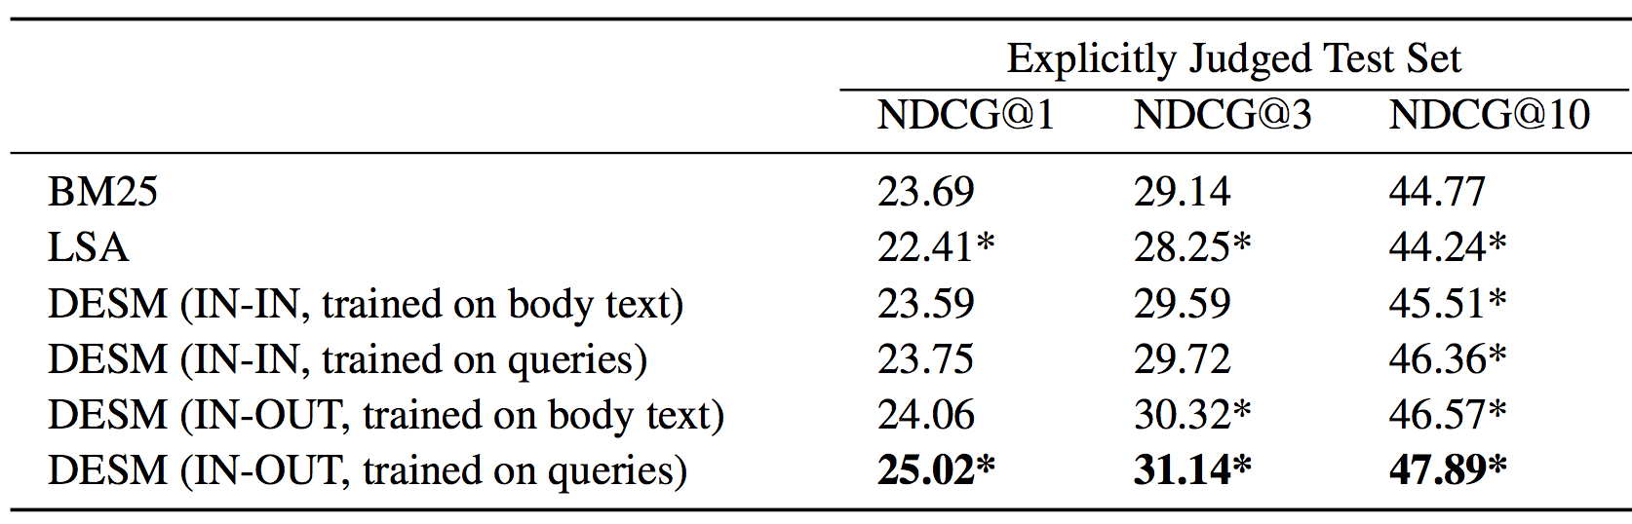
Results – reranking k-best list
Pretty decent gains – e.g., 2% for NDCG@3
Gains are bigger for model trained on queries than docs

Slide 52
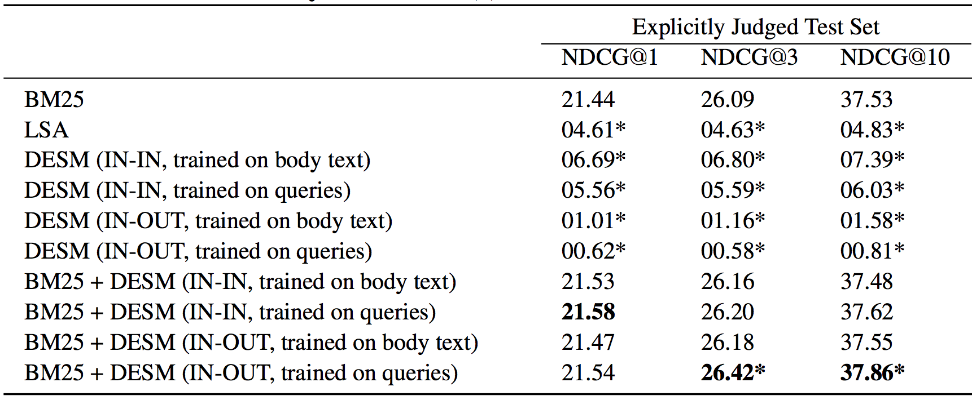
Results – whole ranking system
Notes:
By itself, doesn’t work. Nor does LSA.
Small gains from combination, mainly in-out on queries.
Doesn’t show that distributed word representations don’t work. They’re done broad context here with centroids.

Slide 53

A possible explanation
IN-OUT has some ability to prefer Relevant to close-by (judged) non-relevant, but it’s scores induce too much noise vs. BM25 to be usable alone

Slide 54
DESM conclusions
DESM is a weak ranker but effective at finding subtler similarities/aboutness
It is effective at, but only at, ranking at least somewhat relevant documents
  For example, DESM can confuse Oxford and Cambridge
  Bing rarely makes the Oxford-Cambridge mistake
Notes:
This is where I got to in 2017. Would have to go faster to do the last few slides, but maybe it doesn’t matter and this is fine, and they would only confuse?

Slide 55

Global vs. local embedding [Diaz 2016]

Slide 56

Global vs. local embedding [Diaz 2016]
Train w2v on documents from first round of retrieval
Fine-grained word sense disambiguation

Slide 57

Ad-hoc retrieval using local and distributed representation [Mitra et al. 2017]
Argues both “lexical” and “semantic” matching is important for document ranking
Duet model is a linear combination of two DNNs using local and distributed representations of query/ document as inputs, and jointly trained on labelled data

Slide 58
Summary: Embed all the things!
Word embeddings are the hot new technology (again!)
Lots of applications wherever knowing word context or similarity helps prediction:
Synonym handling in search
Document aboutness
Ad serving
Language models: from spelling correction to email response
Machine translation
Sentiment analysis
…

Slide 60
Thesaurus-based query expansion
Sec. 9.2.2
For each term t in a query, expand the query with synonyms and related words of t from the thesaurus
  feline → feline cat
May weight added terms less than original query terms.
Generally increases recall
Widely used in many science/engineering fields
May significantly decrease precision, particularly with ambiguous terms.
  “interest rate” → “interest rate fascinate evaluate”
There is a high cost of manually producing a thesaurus
  And for updating it for scientific changes

Slide 61
Automatic Thesaurus Generation Issues
Sec. 9.2.3
Quality of associations is usually a problem
Sparsity
Term ambiguity may introduce irrelevant statistically correlated terms.
  “planet earth facts” → “planet earth soil ground facts”
Since terms are highly correlated anyway, expansion may not retrieve many additional documents.
100,000
C
10¹⁰ entries
100,000

Slide 62

COALS model (count-modified LSA)
[Rohde, Gonnerman & Plaut, ms., 2005]

Slide 63
Count based vs. direct prediction
LSA, HAL (Lund & Burgess), COALS (Rohde et al),
Hellinger-PCA (Lebret & Collobert)
NNLM, HLBL, RNN, word2vec Skip-gram/CBOW, (Bengio et al; Collobert & Weston; Huang et al; Mnih & Hinton; Mikolov et al; Mnih & Kavukcuoglu)
Fast training
Scales with corpus size
Efficient usage of statistics
Inefficient usage of statistics
Primarily used to capture word similarity
Generate improved performance
on other tasks
Disproportionate importance given to small counts
Can capture complex patterns
beyond word similarity

Slide 64



Encoding meaning in vector differences
[Pennington, Socher, and Manning, EMNLP 2014]
Crucial insight:
Ratios of co-occurrence probabilities can encode meaning components
x = solid
x = gas
x = water
x = random
large
small
large
small
small
large
large
small
large
small
~1
~1

Slide 65
Encoding meaning in vector differences
[Pennington, Socher, and Manning, EMNLP 2014]
Crucial insight:
Ratios of co-occurrence probabilities can encode meaning components
x = solid
x = gas
x = water
x = fashion
1.9 x 10⁻⁴
6.6 x 10⁻⁵
3.0 x 10⁻³
1.7 x 10⁻⁵
2.2 x 10⁻⁵
7.8 x 10⁻⁴
2.2 x 10⁻³
1.8 x 10⁻⁵
8.9
8.5 x 10⁻²
1.36
0.96

Slide 66







GloVe: A new model for learning word representations
[Pennington, Socher, and Manning, EMNLP 2014]
Notes:
Q: How can we capture this in a word vector space?
A: Log-bilinear model
Fast training
Scalable to huge corpora
Good performance even with small corpus, and small vectors

Slide 67




Word similarities
Nearest words to frog:
1. frogs
2. toad
3. litoria
4. leptodactylidae
5. rana
6. lizard
7. eleutherodactylus
litoria
leptodactylidae
rana
eleutherodactylus
http://nlp.stanford.edu/projects/glove/

Slide 68
Word analogy task [Mikolov, Yih & Zweig 2013a]
Model | Dimensions | Corpus size | Performance (Syn + Sem)
CBOW (Mikolov et al. 2013b) | 300 | 1.6 billion | 36.1
GloVe (this work) | 300 | 1.6 billion | 70.3
CBOW (M et al. 2013b, by us) | 300 | 6 billion | 65.7
GloVe (this work) | 300 | 6 billion | 71.7
CBOW (Mikolov et al. 2013b) | 1000 | 6 billion | 63.7
GloVe (this work) | 300 | 42 billion | 75.0
Notes:
Capturing attributes of meaning through a word analogy task

