Slide 1
Information Retrieval and RAG
The Information Retrieval Task
Notes:
In this set of lectures we introduce the task of information retrieval, the vector space model for solving it, and it's use in the RAG method for LLMs

Slide 2
Information retrieval (IR)
User has an information need
And has some collection of documents
User wants to find a relevant document
  a document (or documents)
  in the collection
  that satisfy their need
Notes:
In the task of Information Retrieval, usually called IR, the user has some information need, and has some collection of documents.
The user is looking for a document in the collection that satisfies their information need
We call such document or documents a "relevant" document

Slide 3
Simple factoid questions
Where is the Louvre Museum located?
Where does the energy in a nuclear explosion come from?
How to get a script l in latex?
Notes:
Information needs could be simple factoid questions

Slide 4
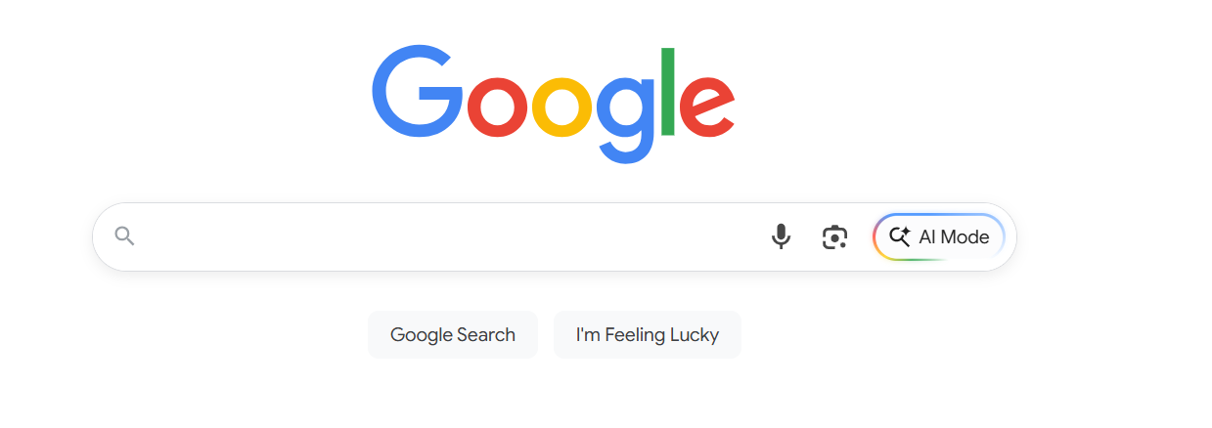
Web search
Notes:
And the classic example of IR, and the classic way to answer factoid questions, is web search.

Slide 5
Not just the web
Searching our email
Searching corporate documents
Searching personal medical records
Notes:
But IR is relevant for more than just the web.

Slide 6
The vector space model of IR
Gerard Salton, 1971
Represent each document as a vector of counts of the words it contains.
Represent a query as a vector too
Return the document whose vector is most similar to the query vector
Notes:
The algorithm we use to retrieve relevant documents is an extension of a pioneering early model called the "vector space" model of IR.

Slide 7
Ranked retrieval
The retriever returns top-k documents
These are ranked
We can show the user these, or some subset.
Notes:
In practice, we often want to return many potential documents, ranked. And we can show the user all or some of these

Slide 8
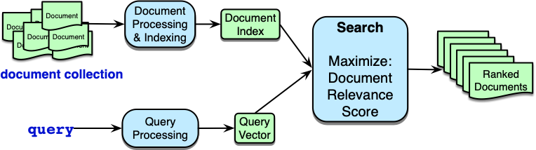
This task is called "ad hoc retrieval"
Notes:
Traditionally this task in which we have single query (unrelated to any other queries, not part of a conversation), and doing ranked retrieval from a document collection is called ad-hoc retrieval,

Slide 9
Document Relevance Score
Goal is to assign a score to each document for whether it meets the user's information need
Instead, we just approximate this by the textual similarity between the query and the document.
Notes:
Now in this document relevance score in the previous slide, the goal…

Slide 10
Two architectures for measuring query-doc relevance (= similarity)
Sparse retrieval
  represent query and doc as vectors of word counts
  weighted by tf-idf, BM25
Dense retrieval
  Use LLM to represent query and doc as embeddings
  In both cases, similarity is usually the cosine between query and document representations
Notes:
There are two standard architectures for doing IR.

Slide 11
Information Retrieval in the LLM Age
If we have some information needs we don't need a document collection!
  Where is the Louvre Museum located?
  Where does the energy in a nuclear explosion come from?
  How to get a script l in latex?
Just prompt an LLM!
Notes:
But wait! Don't we have another way to answer simple factoid questions? If we want to know where the Louvre Museum is located we could just prompt an LLM!

Slide 12
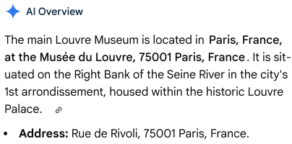
Just prompt an LLM!
LLMs seem to store facts in the connections in their feedforward layers!
Notes:
LLMs seem to have learned facts like this from their pretraining data, and research suggests they store facts in the connections in their feedforward layers!

Slide 13
Information Retrieval in the LLM Age
But IR is still relevant for LLMs!
Retrieving relevant documents can still help solve problems that LLMs have with meeting information needs!
What are these problems?
Notes:
And yet, IR is still quire relevant for LLMs too!
That's because LLMs have problems with meeting information needs, and IR can help!

Slide 14
LLMs Hallucinate
Hallucination: a response that is not faithful to the facts of the world.
In the legal domain LLMs were shown to hallucinate up to 88% of the time!
Dahl et al. (2024)
Notes:
One problem is hallucination!

Slide 15
Can't use Proprietary Data
People need to ask questions about:
personal email
healthcare applications to medical records
internal corporate documents
legal documents discovery
These are (hopefully) not in the pretraining data of large language models!
Notes:
A second problem is that LLMs can't help answer questions about proprietary data!

Slide 16
Can't Handle Dynamic Data
LLMs can't answer questions about rapidly changing information like
the sports match that happened last week
the earthquake that happened this morning
the latest Oscar winner
In general, data shifts over time!
Notes:
Finally, LLMs can't

Slide 17
Solution: RAG
Retrieval-Augmented Generation
Use IR to retrieve documents from some collection
Then use LLM to generate an answer conditioned on the documents
Notes:
The solution to these problems with LLMs for meeting information needs is a family of algorithms called Retrieval-Augmented Generation, or RAG. In this algorithm we specify a relevant collection (like our personal emails or medical records), use IR to retrieve documents from the collection, and then use an LLM to generate an answer conditioned on the documents.

Slide 18
Information Retrieval and RAG
The Information Retrieval Task
Notes:
We've sketched an outline of the IR, information retrieval, task. In the next lectures we'll see how it works!

Slide 19
Information Retrieval and RAG
Sparse retrieval: the vector model of IR
Notes:
Let's see the vector model of IR, including the cosine metric for similarity!

Slide 20
The vector space model of IR
Gerard Salton, 1971
Represent a document as a vector of counts of the words it contains.
Represent a query as a vector too
Return the document whose vector is most similar to the query vector

Slide 21
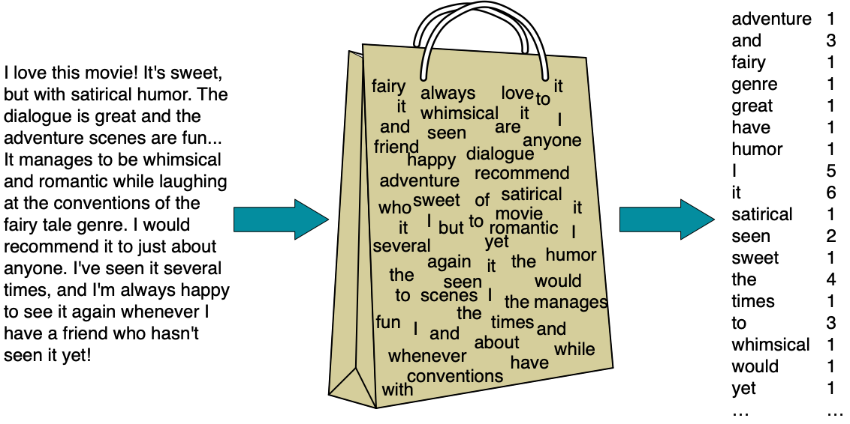
Bag-of-words model

Slide 22
Vector representation of that doc
[1 3 1 1 1 1 1 5 6 1 2 1 4 1 3 1 1 1]
Notes:
We could thus imagine representing that movie review document as this vector
(if we limited ourselves to these 18 dimensions and ignored all the other words in English).

Slide 23
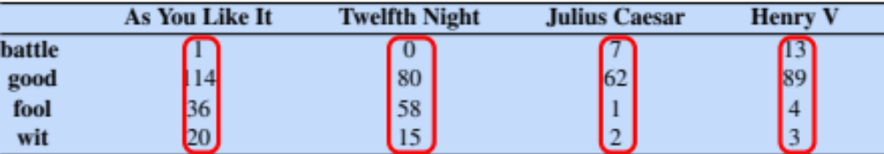
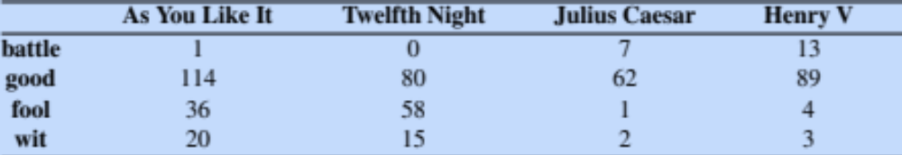
Term-document matrix
Each document is represented by a vector of words
Notes:
Imagine we have a collection of documents, such as all the works of Shakespeare. We can represent documents in such a collection by a term-document matrix, in which each row represents a word in the vocabulary and each column represents a document from the collection.
Here's a small selection from a term-document matrix showing the occurrence of four words in four plays by Shakespeare.
Each cell represents the number of times a particular word (defined by the row) occurs in a particular document (defined by the column).
So fool appeared 58 times in Twelfth Night. We can think of each column as a vector representing a document as a point in |V |-dimensional space; thus the documents in here are points in 4-dimensional space.

Slide 24
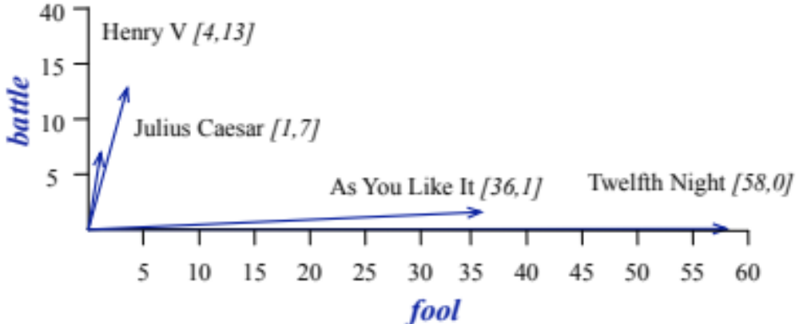
Visualizing document vectors
The two dimensional space [battle, fool]
Notes:
A spatial visualization of the document vectors for the four Shakespeare play documents, showing just two of the dimensions, corresponding to the words battle and fool.
The comedies have high values for the fool dimension and low values for the battle dimension.

Slide 25
Vectors are the basis of information retrieval
The two comedies have similar vectors
But differ from Henry V and Julius Caesar
Comedies have more fools and wit and fewer battles.
Notes:
Two documents that are similar will tend to have similar words, and if two documents have similar words their column vectors will tend to be similar.
The vectors for the comedies As You Like It [1,114,36,20] and Twelfth Night [0,80,58,15] look a lot more like each other (more fools and wit than battles) than they look like Julius Caesar [7,62,1,2] or Henry V [13,89,4,3].
A real term-document matrix, of course, wouldn’t just have 4 rows and columns, let alone 2. More generally, the term-document matrix has |V| rows (one for each word type in the vocabulary) and D columns, one for each document in the collection.

Slide 26
Vector representations of queries and documents
Suppose we are looking for a witty fool play:
Query = "fool wit"
Query
0
0
1
1

Slide 27
Choose the document that is most similar to the query
Which of d₁, d₂, d₃, d₄ is most similar to q?
d₁
d₂
d₃
d₄
q
Query
0
0
1
1

Slide 28
Why dot product for similarity
The dot product tends to be high when the two vectors have large values in the same dimensions
Dot product can thus be a useful similarity metric between vectors
Notes:
The cosine—like most measures for vector similarity used in NLP—is based on the dot product operator from linear algebra, also called the inner product in which we multiply the vectors elementwise and add up to get a scalar value. The dot product acts as a similarity metric because it will tend to be high just when the two vectors have large values in the same dimensions. Alternatively, vectors that have zeros in different dimensions—orthogonal vectors—will have a dot product of 0, representing their strong dissimilarity.

Slide 29
Similarity methods are variants of dot product
The dot product is q ∙ d
score (q,d₄) = q ∙ d₄ =
d₁
d₂
d₃
d₄
q
Query
0
0
1
1
Notes:
0 x 13 + 0 x 89 + 1 x 4 + 1 * 3 = 12
Let's try d2
0 x 0 + 0 x 80 + 1 * 58 + 1 * 15 = 73 that's much higher.
Try pausing the video and compute the dot product of q with the remaining two

Slide 30
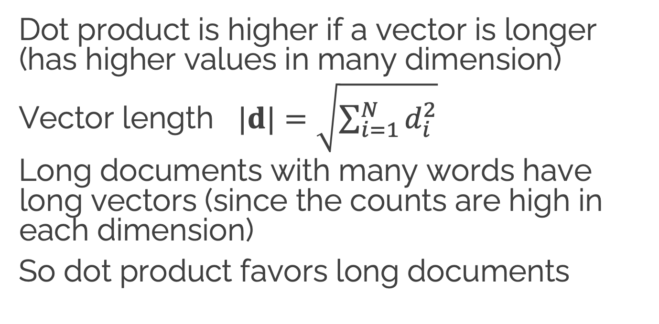
Problem with raw dot-product
Dot product is higher if a vector is longer (has higher values in many dimension)
Vector length $|d|=\sqrt{\sum_{i=1}^{N}{d_{i}^{2}}}$
Long documents with many words have long vectors (since the counts are high in each dimension)
So dot product favors long documents
Notes:
This raw dot product, however, has a problem as a similarity metric: it favors long vectors. The vector length is defined as the square root of the sum of the square of the values
The dot product is higher if a vector is longer, with higher values in each dimension. More frequent words have longer vectors, since they tend to co-occur with more words and have higher co-occurrence values with each of them. The raw dot product thus will be higher for frequent words. But this is a problem; we’d like a similarity metric that tells us how similar two words are regardless of their frequency.

Slide 31

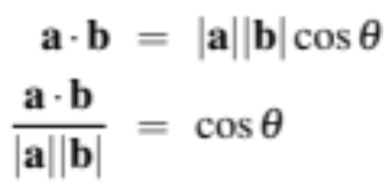
What we use instead to estimate word similarity: cosine
Based on the definition of the dot product between two vectors a and b
Notes:
We modify the dot product to normalize for the vector length by dividing the dot product by the lengths of each of the two vectors. This normalized dot product turns out to be the same as the cosine of the angle between the two vectors (Geometrically, it is the product of the Euclidean magnitudes of the two vectors and the cosine of the angle between them).

Slide 32
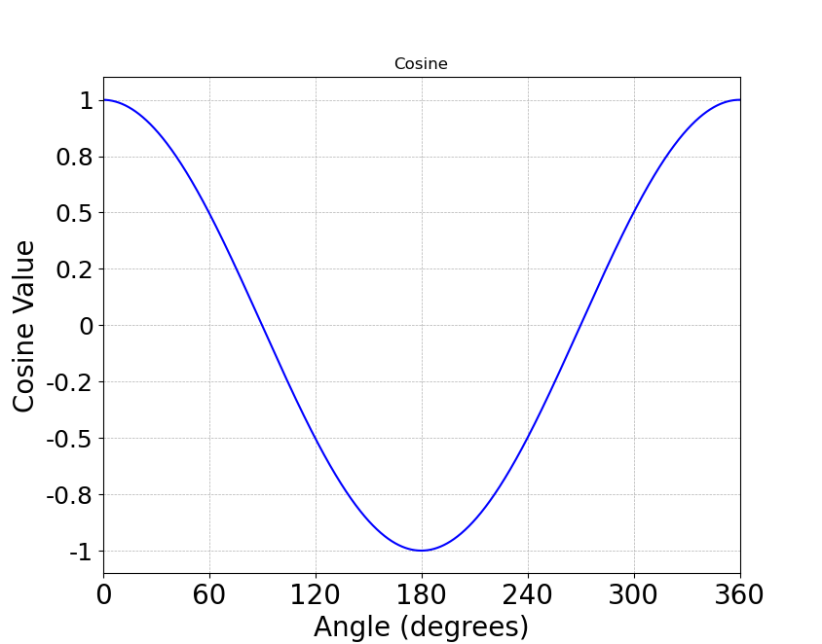
Cosine as a similarity metric
-1: vectors point in opposite directions
+1: vectors point in same directions
0: vectors are orthogonal
Notes:
The cosine value ranges from 1 for vectors pointing in the same direction, through 0 for orthogonal vectors, to -1 for vectors pointing in opposite directions. But since raw frequency values are non-negative, the cosine for these vectors ranges from 0–1.

Slide 33
Cosine as a similarity metric
Since counts are non-negative,
Their vectors lie in the 1st quadrant
So the max angle between them is 90°
So actually the cosine for word count vectors ranges from 0–1
Notes:
The cosine value ranges from 1 for vectors pointing in the same direction, through 0 for orthogonal vectors, to -1 for vectors pointing in opposite directions. But since raw frequency values are non-negative, the cosine for these vectors ranges from 0–1.

Slide 35
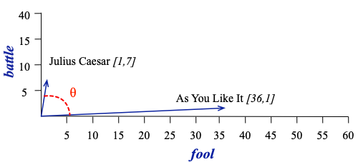
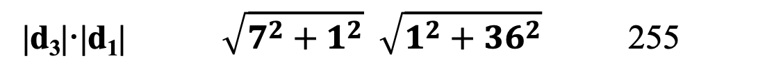
Cosine example with two documents
cos(θ) =
cos(d₃,d₁) =
d₃·d₁ (7×1) + (1×36)
43
=
=
= .17
|d₃|·|d₁| $\sqrt{7^{2}+1^{2}} \sqrt{1^{2}+{36}^{2}}$ 255
d₃
 | d₁: As You Like It | d₃: Julius Caesar
battle | 1 | 7
fool | 36 | 1
d₁

Slide 36
Information Retrieval and RAG
Sparse retrieval: the vector model of IR
Notes:
We've seen the vector model of IR, and the commonly used cosine metric.

Slide 37
Information Retrieval and RAG
TF-IDF
Notes:
It's common to weight the document counts before computing cosines. Here we introduce the popular TF-IDF weighting function.

Slide 38
Raw frequency is a bad representation
The co-occurrence matrices we have seen represent each cell by word frequencies.
Frequency is clearly useful; if fool appears a lot in some documents, that's useful information.
But overly frequent words like the, it, or they are not very informative about the document
It's a paradox! How can we balance these two conflicting constraints?
Notes:
The co-occurrence matrices we've been using represent each cell by frequencies of words in documents. But raw frequency is is very skewed and not very discriminative. If foold appears a lot in a doc, that's useful information. But words like the, or it, which occur frequently in all sorts of docs, aren’t informative about any particular word . It’s a bit of a paradox. How can we balance these two conflicting constraints?

Slide 39

Two common solutions for word weighting
tf-idf: tf-idf value for word t in document d:
PMI: (Pointwise mutual information)
  $\text{PMI}\left(w_{1},w_{2}\right)=log\frac{p(w_{1},w_{2})}{p\left(w_{1}\right)p(w_{2})}$
Words like "the" or "it" have very low idf
See if words like "good" appear more often with "great" than we would expect by chance
Notes:
There are two common solutions to this problem: the tf-idf algorithm, usually used when the dimensions are documents, and algorithms based on pointwise mutual information, or PMI (usually used when the dimensions are words). Tf-idf makes use of a special weight call the "inverse document frequency or "idf", to downweight words like "the" or "it". PMI is a statistical measure that compares the probabilities we see with what we would have expected by change.

Slide 40
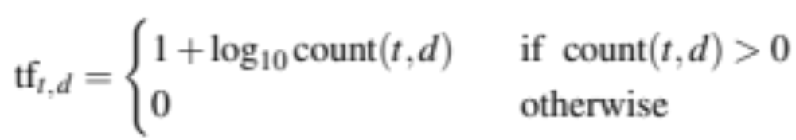
Term frequency (tf) in the tf-idf algorithm
We could imagine using raw count:
tf_{t,d} = count(t,d)
But instead of using raw count, we usually squash a bit:
Notes:
The tf-idf algorithm (the ‘-’ here is a hyphen, not a minus sign) is the product of two factors. The first factor is the term frequency: the frequency of the word t in the document d.
Although we can just use the raw count as the term frequency, more commonly we squash the raw frequency a bit, by using the log10 of the frequency instead. The intuition is that a word appearing 100 times in a document doesn’t make that word 100 times more likely to be relevant to the meaning of the document. Because we can’t take the log of 0, we normally return 0 for counts of 0, and add 1 to the log otherwise, so counts of 0 get a tf of 0, counts of 1 get a tf of 1, but counts of 10 get a tf of 2 (and counts of 5 are in between).

Slide 41
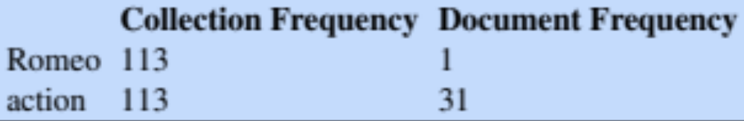
Document frequency (df)
df_{t} is the number of documents t occurs in.
(note this is not collection frequency: total count across all documents)
"Romeo" is very distinctive for one Shakespeare play:
Notes:
The second factor in tf-idf is used to give a higher weight to words that occur only in a few documents. Terms that are limited to a few documents are useful for discriminating those documents from the rest of the collection; terms that occur frequently across the entire collection aren’t as helpful. The document frequency dft of a term t is the number of documents it occurs in .
Document frequency is not the same as the collection frequency of a term, which is the total number of times the word appears in the whole collection in any document. Consider in the collection of Shakespeare’s 37 plays the two words Romeo and action. The words have identical collection frequencies (they both occur 113 times in all the plays) but very different document frequencies, since Romeo only occurs in a single play. If our goal is to find documents about the romantic tribulations of Romeo, the word Romeo should be highly weighted, but not action:
Important: documents can be anything, they don't have to be original documents. For example we often treat each paragraph as a document, which lets use compute tf-idf values for

Slide 42
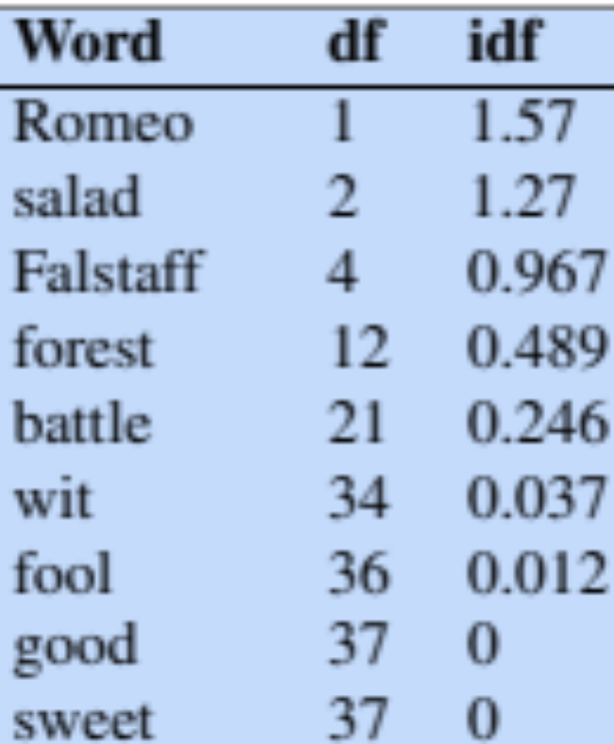
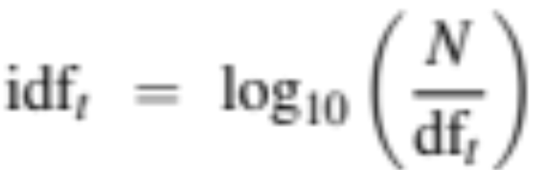
Inverse document frequency (idf)
N is the total number of documents
in the collection
Notes:
We emphasize discriminative words like Romeo via the inverse document fre- quency or idf term weight (Sparck Jones, 1972). The idf is defined using the frac- tion N/dft, where N is the total number of documents in the collection, and dft is the number of documents in which term t occurs. The fewer documents in which a term occurs, the higher this weight. The lowest weight of 1 is assigned to terms that occur in all the documents. Because of the large number of documents in many collections, this measure too is usually squashed with a log function. The resulting definition for inverse document frequency (idf) is thus
Here are some idf values for some words in the Shakespeare corpus, ranging from extremely informative words which occur in only one play like Romeo, to those that occur in a few like salad or Falstaff, to those which are very common like fool or so common as to be completely non-discriminative since they occur in all 37 plays like good or sweet.

Slide 43
What is a document?
Could be a play or a Wikipedia article
But for the purposes of tf-idf, documents can be anything; we often call each paragraph a document!
Notes:
It’s usually clear what counts as a document: in Shake-speare we would use a play; when processing a collection of encyclopedia articles like Wikipedia, the document is a Wikipedia page; in processing newspaper articles, the document is a single article. But very frequently you might need to break up the corpus into documents yourself for the purposes of computing idf. Because that documents can be anything, they don't have to be original documents. For example we often treat each paragraph as a document, which lets use compute tf-idf values even when we are dealing say with a single document like a book.

Slide 44
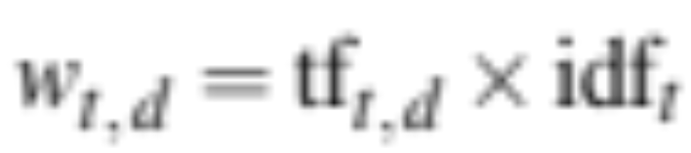
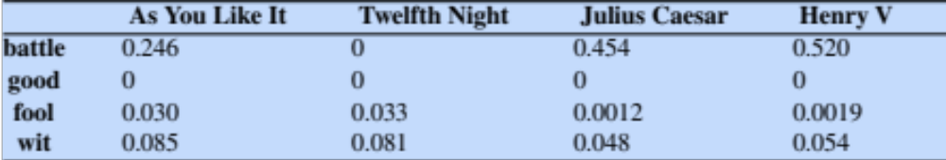
Final tf-idf weighted value for a word
Raw counts:
tf-idf:
Notes:
The tf-idf weighted value wt,d for word t in document d thus combines term frequency tft,d with idf:
Here are the raw counts in the Shakespeare term-document matrix, and the tf-idf weighted version of the same matrix. Note that the tf-idf values for the dimension corresponding to the word good have now all become 0; since this word appears in every document, the tf-idf algorithm leads it to be ignored. Similarly, the word fool, which appears in 36 out of the 37 plays, has a much lower weight.

Slide 45
Information Retrieval and RAG
TF-IDF
Notes:
We've seen the useful tf-idf weighting scheme

Slide 46
Information Retrieval and RAG
TF-IDF: a worked example
Notes:
Let's walk through a detailed nano-example of computing the tf-idf weighted cosine between a query and some documents.

Slide 47

Cosine
Notes:
We'll be computing the score of the query against a document. For each document, we're computing the cos(q,d)

Slide 48

TF-IDF weighted cosine
Notes:
We can instantiate this equation using the tf-idf values and spelling out the dot product as a sum of products:

Slide 49
TF-IDF weighted cosine
Notes:
And just a reminder of how we're computing tf and idf.
So for the query and each document we'll look at each term in the query and multiply these two normalized scores , the normalized tifidf value for the term in the query and the normalized tfidf value for the term in the document.

Slide 50

TF-IDF nano-example
Notes:
Here's our Shakespeare-inspired nano-example. L:et's see what the tf-idf weighted cosine is between the query and some documents.

Slide 51
TF-IDF nano-example
Word | Count | tf 1+log₁₀(c) | df | idf log₁₀N/df) | tf-idf tf x idf | normalized
sweet | 1
nurse | 0
love | 1
how | 0
sorrow | 0
is | 0

Slide 52
TF-IDF nano-example
Word | Count | tf 1+log₁₀(c) | df | idf log₁₀(N/df) | tf-idf tf x idf | normalized
sweet | 1 | 1
nurse | 0
love | 1 | 1
how | 0
sorrow | 0
is | 0
Notes:
Tf is 1 + log10(1) which is 1 plus 0 which is 1
and the document frequence for sweet is 3 (see)
And love is 2 (see)
And the

Slide 53
TF-IDF nano-example
Word | Count | tf 1+log₁₀(c) | df | idf log₁₀(N/df) | tf-idf tf x idf | normalized
sweet | 1 | 1 | 3
nurse | 0
love | 1 | 1 | 2
how | 0
sorrow | 0
is | 0
Notes:
Tf is 1 + log10(1) which is 1 plus 0 which is 1
and the document frequence for sweet is 3 (see)
And love is 2 (see)
And the

Slide 54
TF-IDF nano-example
Word | Count | tf 1+log₁₀(c) | df | idf log₁₀(N/df) | tf-idf tf x idf | normalized
sweet | 1 | 1 | 3 | 0.125
nurse | 0
love | 1 | 1 | 2 | 0.301
how | 0
sorrow | 0
is | 0
Notes:
And N =4 documents, so the IDFs are Log10(4/3) and log10(4/2) which come out to .124 and .301

Slide 55
TF-IDF nano-example
Word | Count | tf 1+log₁₀(c) | df | idf log₁₀(N/df) | tf-idf tf x idf | normalized
sweet | 1 | 1 | 3 | 0.125 | 0.125
nurse | 0
love | 1 | 1 | 2 | 0.301 | 0.301
how | 0
sorrow | 0
is | 0
Notes:
And we just multiple these by the TFs which are both 1.
Next we'll need to compute the denominator, the document vector length for the query and document vectors

Slide 56
TF-IDF nano-example
|q| = √(.125² + .301²) = .325
.125/.325=
Word | Count | tf 1+log₁₀(c) | df | idf log₁₀N/df) | tf-idf tf x idf | normalized
sweet | 1 | 1 | 3 | 0.125 | 0.125 | 0.383
nurse | 0
love | 1 | 1 | 2 | 0.301 | 0.301 | 0.924
how | 0
sorrow | 0
is | 0

Slide 57
TF-IDF nano-example
Word | Cnt | tf 1+log₁₀(c) | df | idf log₁₀N/df) | tf-idf tf x idf | normalized
sweet | 1 | 1 | 3 | 0.125 | 0.125
nurse | 0
love | 0
how | 0
sorrow | 1 | 1 | 1 | 0.602 | 0.602
is | 0

Slide 58
TF-IDF nano-example
|d₂| = √(.125² + .602²) = .615
Word | Cnt | tf 1+log₁₀(c) | df | idf log₁₀N/df) | tf-idf tf x idf | normalized
sweet | 1 | 1 | 3 | 0.125 | 0.125 | 0.203
nurse | 0
love | 0
how | 0
sorrow | 1 | 1 | 1 | 0.602 | 0.602 | 0.979
is | 0
Notes:
.125/.615 = .203
.602/.615 = .979

Slide 59
.
0.203 * 0.383 = 0.0779
.
Word | Cnt | tf 1+log₁₀(c) | df | idf log₁₀N/df) | tf-idf tf x idf | normalized
sweet | 1 | 1 | 3 | 0.125 | 0.125 | 0.203
nurse | 0 |  |  |  |  | 0
love | 0 |  |  |  |  | 0
how | 0 |  |  |  |  | 0
sorrow | 1 | 1 | 1 | 0.602 | 0.602 | 0.979
is | 0 |  |  |  |  | 0
Word | Cnt | tf 1+log₁₀(c) | df | idf log₁₀N/df) | tf-idf tf x idf | normalized | query
sweet | 1 | 1 | 3 | 0.125 | 0.125 | 0.203 | 0.383
nurse | 0 |  |  |  |  | 0 | 0
love | 0 |  |  |  |  | 0 | 0.924
how | 0 |  |  |  |  | 0 | 0
sorrow | 1 | 1 | 1 | 0.602 | 0.602 | 0.979 | 0
is | 0 |  |  |  |  | 0 | 0
Notes:
0.203 *0.383 = 0.0779

Slide 60
Final cosine
(details in
chapter)
score(q,d1) = 0.747
score(q,d2) = 0.0779
  d1 has both terms, including 2 instances of sweet
  d2 is missing one of the terms

Slide 61
Information Retrieval and RAG
TF-IDF: a worked example
Notes:
We've seen all the arithmetic of computing a query-document similarity score using tf-idf weighted cosine!

Slide 62
Information Retrieval and RAG
Efficiency: The Inverted Index
Notes:
Let's turn now to a useful hack for speeding up the ranking computation: the inverted index

Slide 63
Goal: rank documents in D by their TF-IDF-weighted cosines with query q
Do we have to consider all documents in D?
No! We can ignore all documents that don't have any query words!
They will have a cosine of 0!
Notes:
If we want to rank all the documents in our collection D,
by their cosine with the query q

Slide 64
The Inverted Index
How do we efficiently find all documents that contain a query term q_{i}?
An index, that given a term, lists all the documents that have it.
giraffes, 35,72,245
wolverines, 104-110
numbered pages, 1–388
random page numbers, 8, 44–9, 70, 84, 213–28, 337
Which for historical reasons we call an inverted index!
Notes:
If we could avoid processing all those useless documents we could save a lot of time, especially if our collection has a lot of documents
To do that, we need a way to efficiently find all and only the documents that contain a particular query term.

Slide 65
Inverted Index
Two parts
Dictionary:
how
is
love
nurse
sorrow
sweet
Postings:
→ 3
→ 3
→ 1→ 3
→ 1 → 4
→ 2
→ 1→ 2 → 3
Notes:
An inverted index, given a query term, gives a list of documents that contain the term. It consists of two parts, a dictionary and the postings. The dictionary is a list of terms (designed to be efficiently accessed, like by a hash), each pointing to a postings list for the term. A postings list is the list of document IDs associated with each term,

Slide 66
Inverted Index Creation
1. Sort by term and document
2. Create linked postings list
Term Doc#
sweet 1
sweet 1
nurse 1
love 1
sweet 2
sorrow 2
how 3
sweet 3
is 3
love 3
nurse 4
Term Doc#
how 3
is 3
love 1
love 3
nurse 1
nurse 4
sorrow 2
sweet 2
sweet 1
sweet 1
sweet 3
Dict:
how
is
love
nurse
sorrow
sweet
Postings:
→ 3
→ 3
→ 1→ 3
→ 1 → 4
→ 2
→ 1→ 2 → 3
→
→
→
Notes:
How do we compute an inverted index? We start with the documents, then walk through the documents storing a list of each word instance that occurs, and the document it occurs in.
Then we sort by term and document,
And create a linked postings list

Slide 67
Inverted Index
Dict
how
is
love
nurse
sorrow
sweet
Postings
→ 3
→ 3
→ 1→ 3
→ 1 → 4
→ 2
→ 1→ 2 → 3
Notes:
So agan here's a picture of the final inverted index.

Slide 68
So far this just tells us which documents to grab
But we also need enough information to compute tf-idf:
For each term t in vocabulary:
  The df_{t} (document frequency) of word t
For each term t in each document d:
  The term frequency or count(t,d) of term t in doc d
Notes:
Wait, we need to add more information to the inverted index. We need information to compute tf-idf!
So we need the term frequency for each term in each document. And we need the document frequency for each term.

Slide 69

Doc#
tf
df
Notes:
For example each term has a document frequency so we can store it with each dictionary entry. And each term in each document has a term frequency, so the postings list will need to be updated with a tf for each mention of a document.
Given a list of terms in query, we can very efficiently get lists of all candidate documents, together with the information necessary to compute the tf-idf scores we need.

Slide 70
Information Retrieval and RAG
Efficiency: The Inverted Index
Notes:
In summary, the inverted index is a standard way of efficiently storing the information we need to compute query-document similarities even with a very large document collection

Slide 71
Information Retrieval and RAG
Evaluation of IR
Notes:
Let's stalk about how to evaluate IR

Slide 72
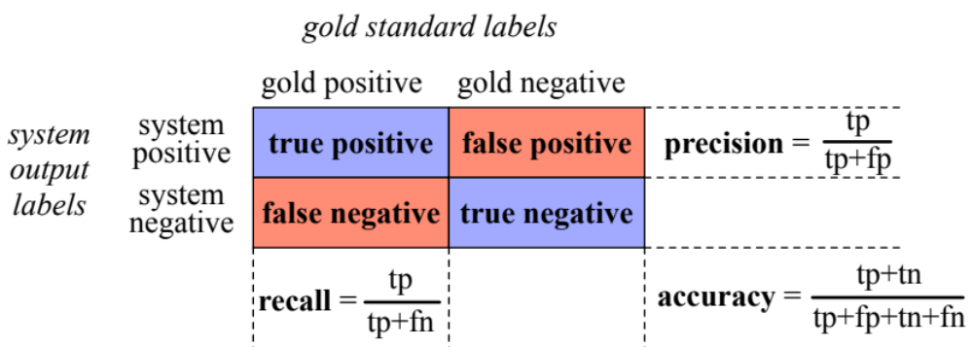
Precision and Recall
We saw these already for classification
Precision: % of returned items that are correct
Recall: % of correct items that are returned

Slide 73
Precision and Recall for IR
User makes an information request
Every document in collection is either:
Relevant to the user
Not relevant to the user
The system retrieves a ranked set of documents
Notes:
Now let's think about precision and recall for IR.
In the IR context,

Slide 74
Precision for IR
Precision = % of retrieved documents that are relevant
System retrieves two kinds of documents
relevant documents
irrelevant documents
|relevant retrieved docs|
Precision = ----------------------------------------
|relevant retrieved docs| + |irrelevant retrieved docs|
Notes:
Precision is out of the documents the system returned, how many did it get right? how many were true positives, out of what I returned (true positives + false positives).

Slide 75
Recall for IR
Recall = % of relevant documents that are retrieved
Recall = |retrieved relevant documents|
-------------------------------
|all relevant document|
Notes:
Recall is out of all the correct documents that should have been positive, what % of them did the IR system return? So out of all the documents that are gold positive, how many did the system find as true positives?
So precision is about how much garbage we included in the list of documents we returned; recall is more about making sure we didn't miss any treasure.

Slide 76
Precision and Recall aren't enough
This is ranked retrieval
Given two ranked retrieval systems
We want a metric that prefers the one that ranks relevant documents higher
We need to adapt precision and recall!
to be sensitive to where in the ranking the relevant document occur
Notes:
But this is still not sufficient to apply precision and recall to IR. The reason is that in IR we don't generally just return a single document.
Instead, we're doing ranked retrieval, where we return the documents ranked for relevance.

Slide 77
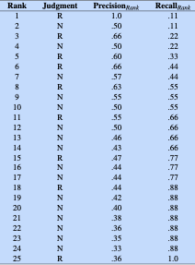
Rank-specific precision and recall
Example:
25 documents
9 are relevant
If we return all 25
P=.36, R= 1.0
Suppose we just return one (and it is relevant)?
Notes:
Let's define a rank-specific precision and recall.
The precisions are the fraction of relevant documents seen at a given rank, and recalls the fraction of relevant documents found at the same rank
For example, suppose we had 25 documents of which 9 are relevant. Clearly if we return all 25, our precision is 9/25 and our recall is 1.
But suppose we just returned 1, and it is relevant? Now our precision is 1, since we only returned one document and it's relevant. And our recall is 1/9 since we found 1 of the 9 relevant documents.

Slide 78
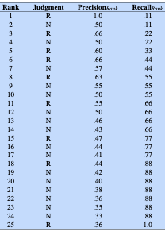
Rank-specific precision and recall
Recall is non-decreasing
Relevant docs increase recall
Non-relevant docs don't
Precision jumps up and down
increasing for relevant docs
decreasing otherwise.
Notes:
Now let's imagine computing this rank-specific precision and recall for every rank up to N, the number of documents.
Here the precisions are the fraction of relevant documents seen at a given rank, and recalls the fraction of relevant documents found at the same rank.
So for example at rank 10, we've seen 5 relevant documents and 5 nonrelevant, so precision is .5, and we've seen 5 out of the 9 relevant documents, so recall is 5/9
Noe that recall is non-decreasing!
But precision jumps up and down. Increasing for relevant docs, decreasing otherwise.
So if we go to rank 11, we've seen one more relvant document, so precision goes up from 5/10 to 6/11
but then at rank 12, it's irrelevant, so precision is back to .5, 6/12

Slide 79
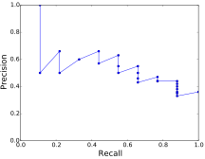
The precision-recall curve (for one query)

Slide 80
Need a metric that aggregates over many queries
Two common approaches
Mean Average Precision
Interpolated Precision

Slide 81
Mean Average Precision
Descend through ranked items
Note precision only if item is relevant
e.g. ranks 1, 3, 5, 6 but not 2 or 4:
Precision_{r}(d) "ranked precision"
precision at the rank doc d was found.
Notes:
We descend through the ranked list of items, and note the precision only at those points where a relevant item has been encountered (for example at ranks 1, 3, 5, 6 but not 2 or 4

Slide 82

Average Precision
Descend through ranked items
Note precision only if item is relevant
Take the average of the ranked-precisions
R_{r} is the set of relevant documents at or above r
Precision_{r}(d) is precision measured at the rank at which document d was found.
Notes:
For a single query, we average these individual precision measurements over the return set (up to some fixed cutoff).
More formally, if we assume that Rr is the set of relevant documents at or above r, then the average precision (AP) for a single query is
where Precisionr(d) is the precision measured at the rank at which document d was found.

Slide 83

Mean Average Precision
For a set of Q queries
Mean Average Precision (MAP):
Notes:
For an ensemble of queries Q, we then average over these averages, to get our final MAP measure:
The MAP for the single query (hence = AP) in Fig. 11.7 is 0.6.
It can sometimes be confused that we have the word "Mean" and "Average". Average precision measn averaging over documents; it's a value for a single query. Mean average precision means averaging over queries, averaging over the average precision for each query

Slide 84
Information Retrieval and RAG
Evaluation of IR
Notes:
We've introduced the Mean Average Precision metric used to evaluated ranked IR systems

Slide 85
Information Retrieval and RAG
Dense Retrieval
Notes:
Modern information retrieval uses a more sophisticated way to represent query and document vectors, called dense retrieval

Slide 86
Problem with classic IR
The vocabulary mismatch problem
tf-idf cosine similarities measure query-doc similarity only if there is exact word overlap between query and doc!
But query-writer can't know the exact words the doc might include!
  Maybe query says "premiere" and document says "opening night"?

Slide 87
Dense retrieval
We still compare document vectors with query vectors to rank documents
But instead of representing query and documents with count vectors
We represent both with dense embeddings!
Here's a quick preview of embeddings; more details in future lectures

Slide 88
Sparse versus dense vectors
Count vectors (even if weighted by tf-idf)
  big (# of elements = |V|= 20,000 to 50,000)
  sparse (most elements are zero)
Alternative: learn vectors which are
  small (# of elements 50-1000)
  dense (most elements are non-zero)
Notes:
Unlike the vectors we’ve seen so far, embeddings are short, with number of elements d ranging from 50-1000, rather than the much larger vocabulary size |V | or number of documents D we’ve seen. These d dimensions don’t have a clear interpretation. And the vectors are dense: instead of vector entries being sparse, mostly-zero counts or functions of counts, the values will be real-valued numbers that can be negative.

Slide 89
Dense retrieval
We use LLMs like BERT to compute dense vectors to represent the query and the document
These vectors are contextual embeddings

Slide 90
Dense embeddings for each word
Output vectors
V1 v2 v3 v4 v5 v6 v7 v8
BERT Encoder
Input words
When was the premiere of The Magic Flute?
Notes:
An Encoder is a kind of language model that maps each word, in its context, into a dense embedding vector that represents the meaning of that word in its context. So what does this vector V4 represent?

Slide 91
Contextual embeddings
Each vector represents the meaning of a word in its context
V4 represents the meaning of:
  the word premiere in the context "When was the _____ of The Magic Flute"
Contextual embeddings might be 1000 or 4000 dimensions.
Notes:
… so V4 might be a dense 1000-dimensional vector

Slide 92
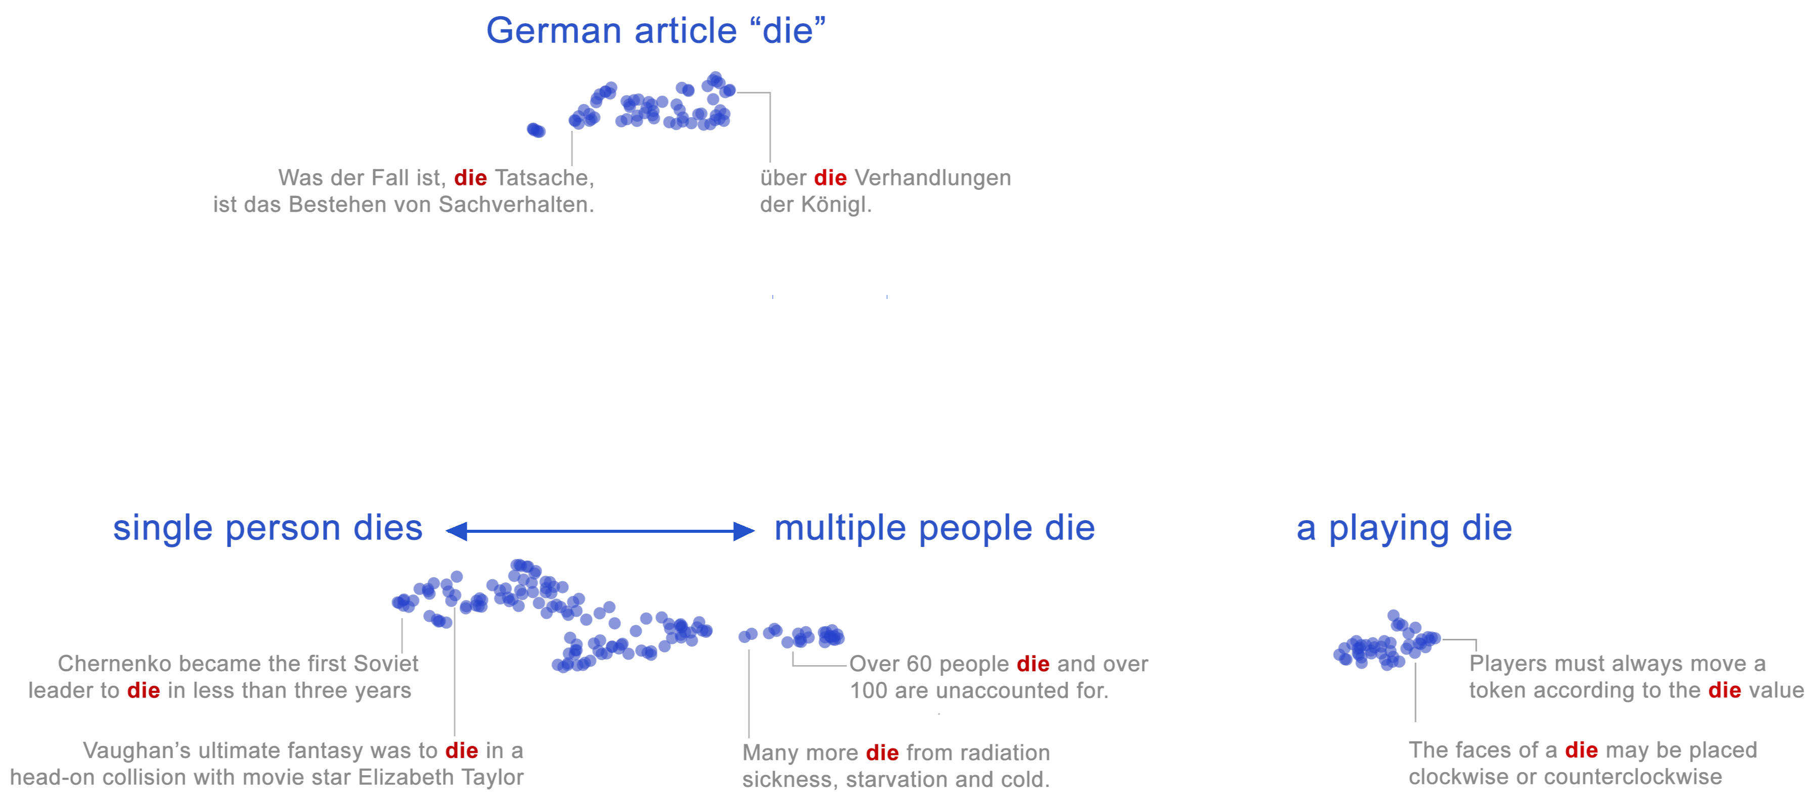
Contextual word embeddings
Each word instance in context is represented as a single point in space
The meaning of a whole word is a region (a cloud of points) in 1000-dim space!
The word "die" in 2D, showing two regions for two senses
Coenen et al. (2019)
Notes:
What do these vectors look like?

Slide 93
Contextual embeddings
But not just two discrete senses

Slide 94
Dense vectors for each query
Query
output vectors
q1 q2 q3 q4 q5 q6 q7 q8
BERT Encoder
query
When was the premiere of The Magic Flute?
Notes:
So to return to the IR case, we can pass a query through a LLM encoder, and get out a vector for each word in the sentence

Slide 95
Dense vectors for each query
One CLS vector
representing
sentence
CLS
q1 q2 q3 q4 q5 q6 q7 q8
BERT Encoder
query
When was the premiere of The Magic Flute?
Notes:
LLMs like BERT can do something even fancier, which is that they can output a single embedding that integrates the meanings of each of these words to represent the whole sentence. This embedding is called the CLS output, which stands for Classification, since it's often used for classification tasks.

Slide 96
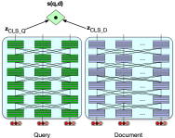

Simplest dense retrieval (biencoder)
Score is dot product between query vector and document vector
Notes:
So to compute the similarity score between a query and a document, we run both through a BERT LLM encoder,, and then use the dot product between the CLS outputs for the query and document as the score.

Slide 97
Making dense retrieval efficient
Pre-encode all the document vectors in advance.
Encode query when it arrives

Slide 98
Efficiency in dense retrieval
We must rank every document for its similarity to the query!
Efficiency for sparse word-count vectors: inverted index
Efficiency for dense retrieval:
nearest neighbor search: finding the set of dense document vectors that have the highest dot product with a dense query vector.
Approximate nearest neighbor algorithm Faiss (Johnson et al., 2017).
  Approximates the doc vector by a smaller quantized vector

Slide 99
More on dense retrieval

Slide 100
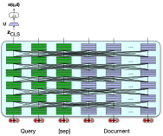
Dense retrieval #2: Single encoder
More expensive than biencoder
But more accurate
Notes:
Use a single encoder to jointly encode query and document and finetune to produce a relevance score with a linear layer over the CLS token
The bi-encoder is much cheaper than a full query/document encoder, but is also less accurate, since its relevance decision can’t take full advantage of all the possible meaning interactions between all the tokens in the query and the tokens in the document. The single encoder can do that.

Slide 101
Dense retrieval #2: Single encoder
System is run on passages (say 100 tokens) instead of whole documents
Training:
BERT and linear layer U can then fine-tuned for relevance
Creating a tuning dataset of relevant and non-relevant passages.

Slide 102
In-between dense retrieval methods
Use cheap methods (like BM25) as first pass relevance ranking for each document,
Then just rerank the top N ranked docs,
Using expensive methods like the full BERT scoring

Slide 103
ColBERT
Precompute document but store each word vector
Then do maxsim between document and query words
Khattab and Zaharia (2020), Khattab et al (2021)

Slide 104
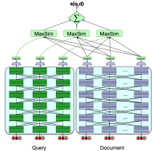

ColBERT
Notes:
The query and docu- ment are first passed through separate BERT encoders. Similarity between query and doc- ument is computed by summing a soft alignment between the contextual representations of tokens in the query and the document. Training is end-to-end.
a question q is tokenized as [q1,...,qn], prepended with a [CLS] and a special [Q] token, truncated to N=32 tokens (or padded with [MASK] tokens if it is shorter), and passed through BERT to get output vectors q = [q1,...,qN]. The passage d with tokens [d1,...,dm], is processed similarly, including a [CLS] and special [D] token. A linear layer is applied on top of d and q to control the output dimension, so as to keep the vectors small for storage efficiency, and vectors are rescaled to unit length, producing the final vector sequences Eq (length N) and Ed (length m). The ColBERT scoring mechanism is:

Slide 105
Training for dense retrieval
ColBERT and other models need to be trained
To fine-tune the BERT encoders and train the linear layers (and the special [Q] and [D] embeddings)
On datasets of triples ⟨q,d+,d−⟩
Some datasets like MS MARCO Ranking have positive examples

Slide 106
Information Retrieval and RAG
Dense Retrieval
Notes:
We've seen the more sophisticated dense retrieval method for IR.

Slide 107
Information Retrieval and RAG
Retrieval-Augmented Generation
Notes:
Let's see how IR can be relevant to large language models in the retrieval-augmented generation method

Slide 108
IR plays a central role in modern LLMs
LLMs can answer some information needs without a document collection!
  Where is the Louvre Museum located?
  Where does the energy in a nuclear explosion come from?
  How to get a script l in latex?
Just prompt an LLM!
Notes:
IR can play an important role in LLMs! Why is that true? After all, If we want to know where the Louvre Museum is located we could just prompt an LLM!

Slide 109
Just prompt an LLM!
LLMs seem to store facts in the connections in their feedforward layers!
Notes:
LLMs seem to have learned facts like this from their pretraining data, and research suggests they store facts in the connections in their feedforward layers!

Slide 110
But there are issues we mentioned earlier!
LLMs hallucinate, giving answers that aren't faithful to the facts of the world.
They can make up medical, legal facts
LLMs can't use proprietary data
Email, medical records, corporate docs
LLMs can't handle dynamic data
Recent news, earthquakes, sports events

Slide 111
Solution: RAG
Retrieval-Augmented Generation
Use IR to retrieve documents from some collection
Then use LLM to generate an answer conditioned on the documents
Notes:
The solution to these problems with LLMs for meeting information needs is a family of algorithms called Retrieval-Augmented Generation, or RAG. In this algorithm we specify a relevant collection (like our personal emails or medical records), use IR to retrieve documents from the collection, and then use an LLM to generate an answer conditioned on the documents.

Slide 112
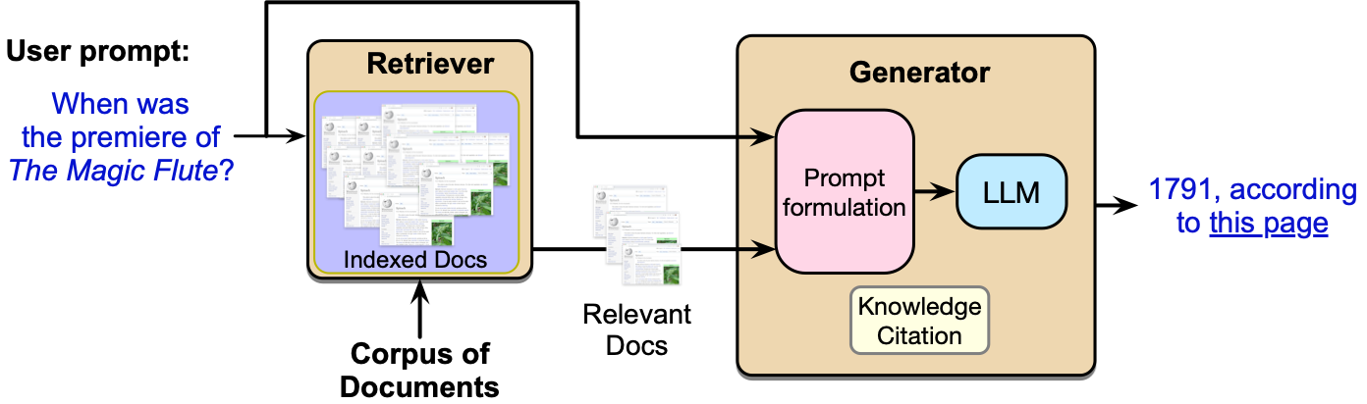
Retrieval Augmented Generation (RAG)
Notes:
Retrieval-augmented generation takes as input a user prompt (which may express an information need like this question example), and a corpus of documents that may be useful in meeting the information need.
The method has two stages: retrieval, which returns relevant documents from the collection, and generation, in which an LLM generates text given the documents as a prompt.
Some generations include a knowledge citation that can help the user decide whether to trust the generation, or follow up if they are interested.

Slide 113
Basic RAG
Given a document collection D and a user query q
Call a retriever to return top k passages
Create a prompt that includes q and the passages
Call an LLM with the prompt
Notes:
Given a document collection D and a user query q, the most basic RAG algorithm is:

Slide 114
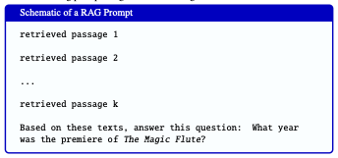
Notes:
The resulting prompts might look something like:

Slide 115
Notes:
The task for the language model is then to generate text according to this probability model:

Slide 116
Extensions: Agent-based RAG
Instead of running RAG automatically on every user turn
Have a retrieval agent
System decides when to call the retrieval agent and for which document collection
Notes:
There are many augmentations of this basic RAG paradigm.
One addition is the use of agent-based RAG. In the RAG paradigm described so far, a search is always run and then retrieved passages are combined with the user’s question in a prompt.
But in actual applications, we may not want to run retrieval for every user turn.
Or we may want to retrieve from different collections for different user needs (sometimes the web, other times a private collection).
In agent-based RAG, the system decides when to call a retrieval agent and for which collection.

Slide 117
Extensions: Training
Instruction-tune an LLM on a dataset of questions with retrieved passages and correct answers
Test-time compute: prompt an LLM to answer the question and simultaneously to generate reflections on which passages were useful
Notes:
Another class of solutions is to train the LLM for RAG. The basic version of RAG describe above involves no training; we take an off-the-shelf LLM, and give it the passages and a prompt and hope that it will correctly figure out which passages are useful or relevant in generating the answer.
One learning variant involves instruction-tuning an LLM, by first creating a dataset of questions annotated with retrieved passages and correct answers, and then instruction-tuning the LLM to correctly answer the questions from the passages.
An alternative method is to do this via test-time compute, prompting the LLM to answer the question and simultaneously to generate reflections on which passages were useful.
In addition to training the LLM, we could train the IR engine. After all, the IR engine itself has not been optimized for the RAG scenario.

Slide 118

Extensions: Knowledge Citations
‘‘Write an answer for the given question using only the provided search results (some of which might be irrelevant) and cite them properly... Always cite for any factual claim".
Notes:
it is generally useful for LLMs to give the user evidence for any factual statement. This can be in the form of knowledge citations, such as URLs of a trusted source or citation references to particular literature. For example a question answering system might generate numbered pointers to URLs as follows:
The simplest way for generating knowledge citations is to specify it as part of the prompt.

Slide 119
Information Retrieval and RAG
Retrieval-Augmented Generation
Notes:
We've now seen the Retrieval-Augmented Generation or RAG method

Slide 120
Information Retrieval and RAG
Question Answering datasets and evals

Slide 121
Two kinds of question answering datasets
Natural information-seeking questions
Someone actually wanted to know the answer to this
Probing (testing) questions
Exam-type questions for LLM evaluation

Slide 122
Natural Questions
(Kwiatkowski et al., 2019),
anonymized English queries to the Google search engine and short and long answers (hand-created from Wikipedia)
“When are hops added to the brewing process?”
short answer: the boiling process
long answer: paragraph from the Wikipedia page on Brewing

Slide 123
MS MARCO (Microsoft Machine Reading Comprehension) collection of datasets,
1 million real anonymized English questions from Microsoft Bing query logs
human generated answer
9 million passages (Bajaj et al., 2016)

Slide 124

Probing dataset: MMLU
15908 knowledge and reasoning questions in 57 areas including medicine, mathematics, computer science, law, etc..
Sourced from exams for humans like GRE, AP

Slide 125
Information Retrieval and RAG
Question Answering datasets and evals

